Slide 1
Notes:
Welcome, thank you for coming out.
A really important moment to be having this conversation - UNFCCC
Would be great to get a sense of who is in the room:
Who here is part of a defined benefits plan? (okay if you aren’t - because we’re all members of CPPIB)
OTTP? OMERS? HOOPP? OPTRUST? PSP? OBP? - out of province? BCIMC? others?

Slide 2

Shift: Action for Pension Wealth and Planet Health
works to protect pensions and the climate by bringing together beneficiaries and pension funds to engage on the climate crisis. We help Canadians understand where their retirement wealth is invested and how to engage with the people managing it. Now is the time to shift our approach and invest in a low-carbon future.
Notes:
Shift is a small non-profit project, funded by charitable foundations.
We have two primary goals:
Protect the retirement savings of Canadians from the risks of the climate crisis
To use the power of those retirement savings to help stop the climate crisis from getting worse
We are a three person team - we are focused on providing education, strategy and tools to Canadians. While we do talk to pension managers - it’s not as if the funds are all that motivated to act just in speaking to a small non-profit.
The real power lies with you - the beneficiaries. The pension funds managers work for you - they have been hired to manage your hard earned retirement wealth. They have legal responsibility to you.
So you are in change. We want to help you be as effective as possible in working constructively with your pension plan to make a difference on climate change.
So why Pensions? - They are hard-earned wages of Canadians - we need to protect them. These pooled savings are also the largest pools of capital on the planet.
Just the top 10 pensions in Canada are $1.5 tn assets under management.

Slide 3
Workshop Outline
Introductions
Understanding the climate crisis
Climate risks to retirement savings
Pension opportunities
How are Canada’s pension plans preparing?
How to engage and have impact
Questions & Discussion

Slide 4
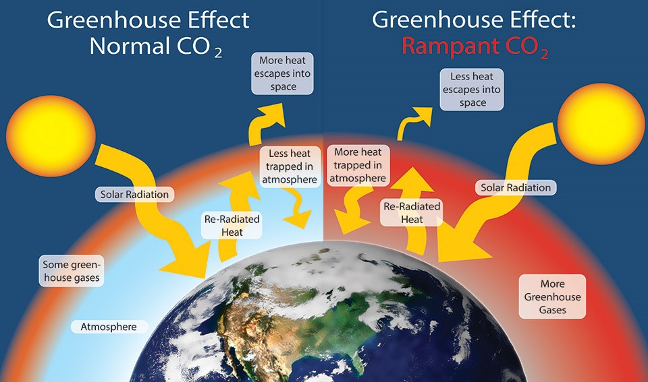
Climate Crisis 101
Notes:
Climate crisis 101:
A recap for many of you I am sure, but it’s critical to understand.
The temperature of our planet is the result of a complex balance.
Since the start of the industrial revolution - the composition of our atmosphere has been changed dramatically.

Slide 5
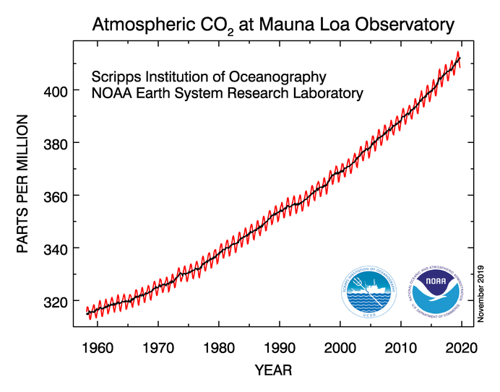
Source: Scripps Institution of Oceanography / National Oceanic and Atmospheric Administration. Earth System Research Laboratory Global Monitoring Division. (2019).
Notes:
The concentration of CO2 in the earth’s atmosphere has increased by more than 50% in a very short period of time. Primarily due to the combustion of fossil fuels.

Slide 6
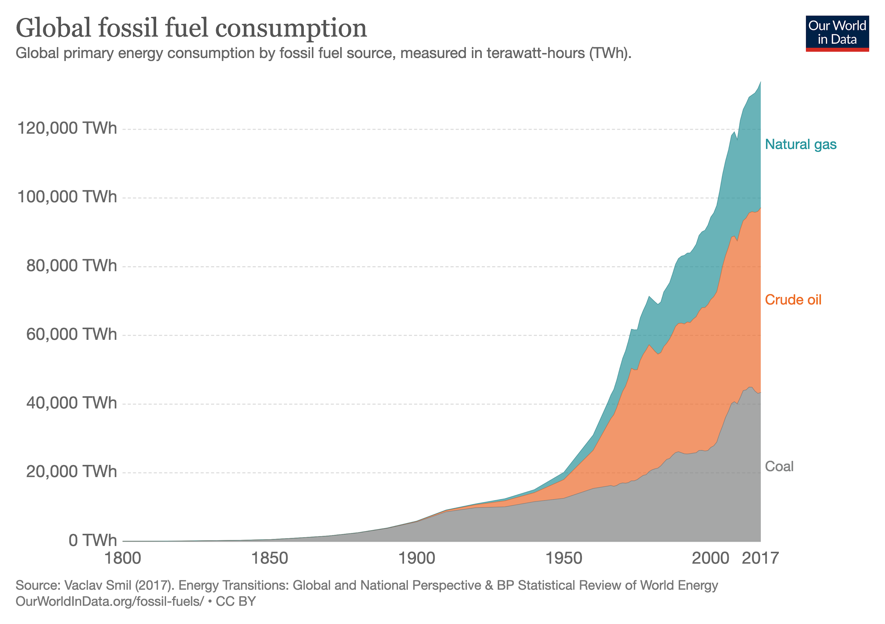
Notes:
This graph shows the growth in the burning of coal, oil and gas - carbon that was previously safely trapped in the ground - has been dumped into our atmosphere - significantly upsetting the balance.

Slide 7
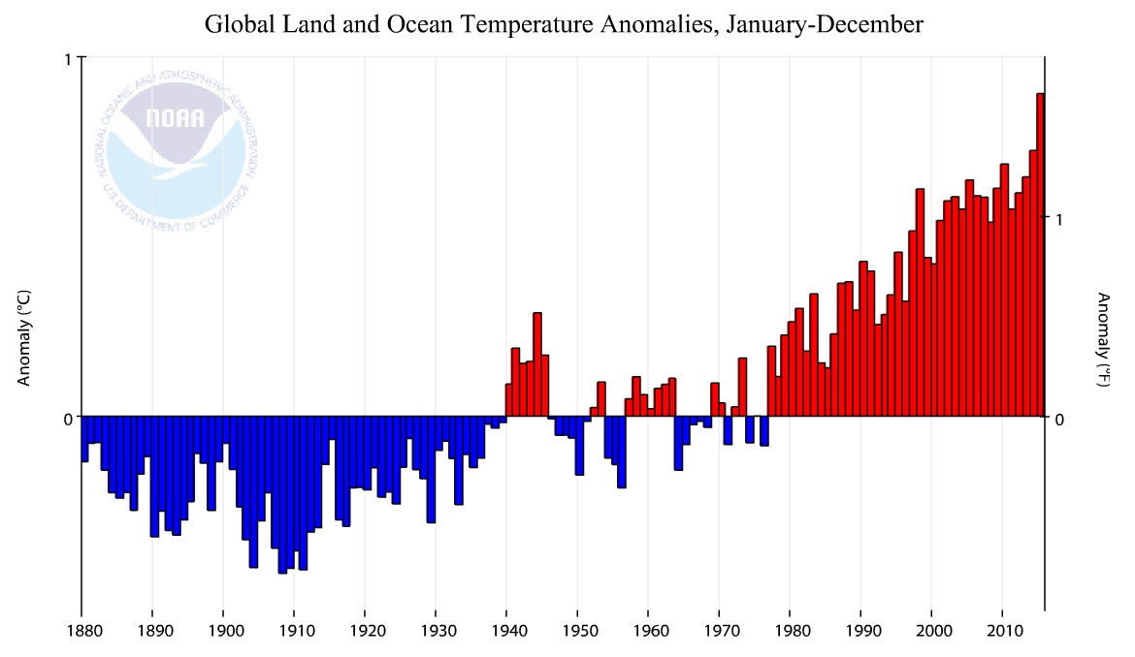
Source: National Oceanic and Atmospheric Administration. Global Temperature Anomalies – Graphing Tool. (2019)
Notes:
Here is a graph showing temperature data from the U.S. National Oceanic and Atmospheric Administration over that same period.
The greenhouse effect is itself governed by fairly basic physics. However, the link between fossil fuel combustion and increasing global average surface temperatures has also been thoroughly established and observed independently by every single relevant scientific field - atmospheric physics, biologists, paleontology, oceanographers, forestry, etc…
There is scientific consensus - on the exact causes, on the effects, and even on the solutions and has been for decades now.

Slide 8
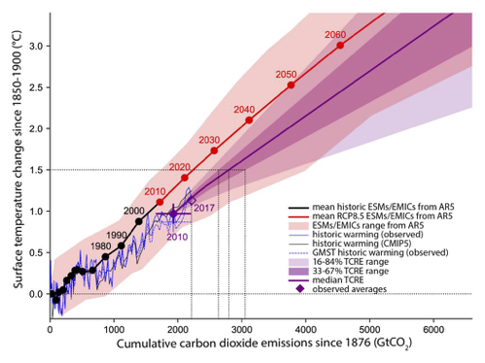
Source: International Panel on Climate Change. Temperature changes from 1850-1900 versus cumulative CO2 emissions since 1st January 1876. (2019).
Notes:
A quick overview of the climate crisis.
As we sit here this morning - we are on track for more than 3 degrees of warming this century - accelerating upwards from there. This is a globally averaged number. Canada is warming roughly three times faster than the average.
We are currently on a path to following the blue line on this graph.
Warming at that level threatens the underlying security of our world. Entire ecosystems, and our human societies hang in the balance. I want to underline just how gravely serious this threat is. In our day to day lives, it doesn’t always feel like we are in a crisis situation - in an emergency. But we are.
Young people around the world are currently trying to snap us out of the fog we live in - going about our day to day activities, trying not to think about this issue. There is at times, a generational disconnect about the severity of the situation.
One of the reasons perhaps why we try not to think about the climate crisis, is that we are - all of us- struggling to think of ways that we can make a real difference in our everyday lives. We lack for tools at our disposal.
I have some hope for you. We at Shift think we have a new, meaningful lever to pull that will make a difference. Engaging your pension fund or financial managers to address the climate crisis.
We hope that in considering stepping up and engaging with your pension fund - you will feel empowered and a little less hopeless.
We can get our climate pollution to zero by the middle of this century.

Slide 9
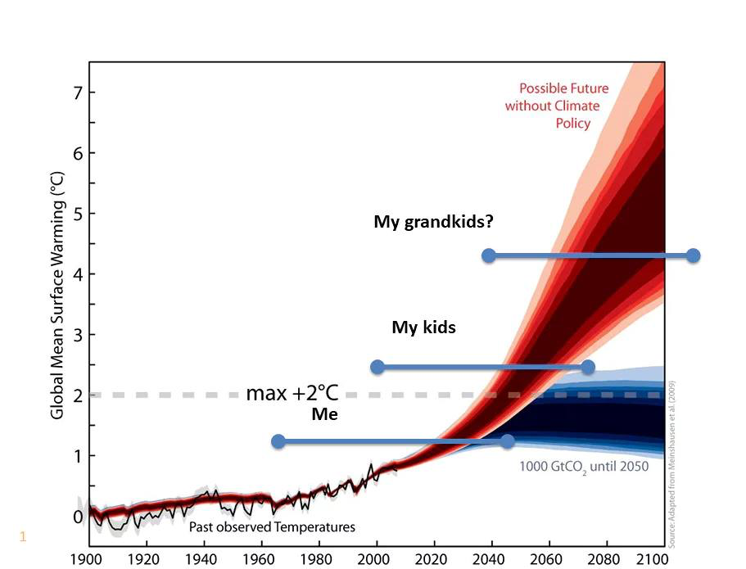
Source: Ketan Joshi. “Caring about climate change: it’s time to build a bridge between data and emotion.” The Guardian (7 June 2017).
Notes:
This graph has an impact on me.
I’m a new dad. I have a three year old at home with another on the way.
My lifespan is represented by the bottom blue bar. We are already facing serious impacts from a warming world, but my kids - perhaps your grandkids are going to have their world turned on its head.
In discussions about climate - we often talk about intergenerational equity. What sort of world are we leaving as a legacy for future generations?

Slide 10
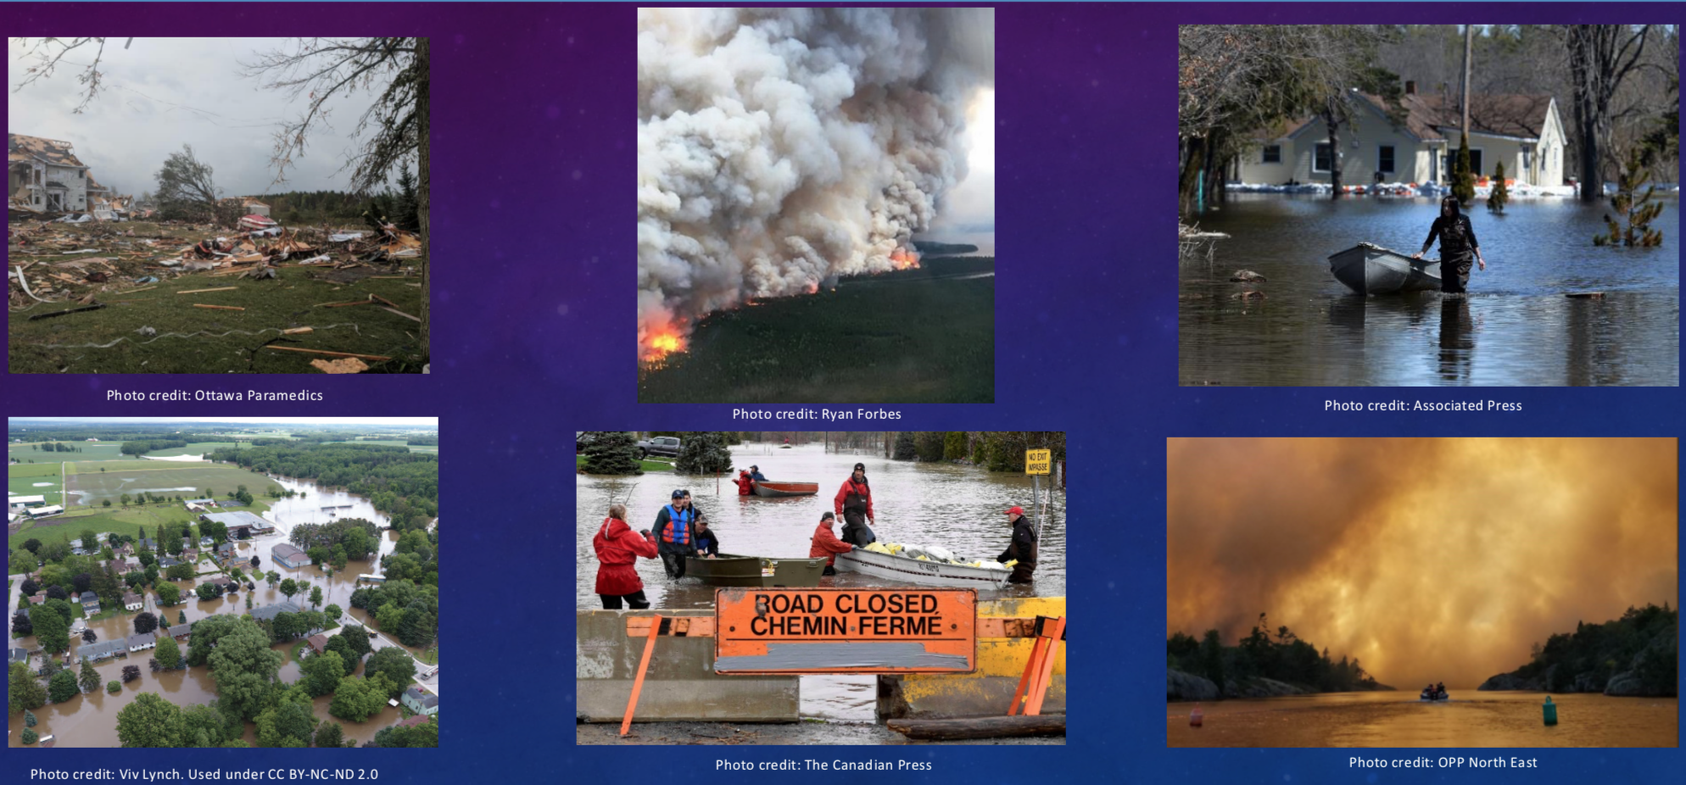
The impacts are already here

Slide 11
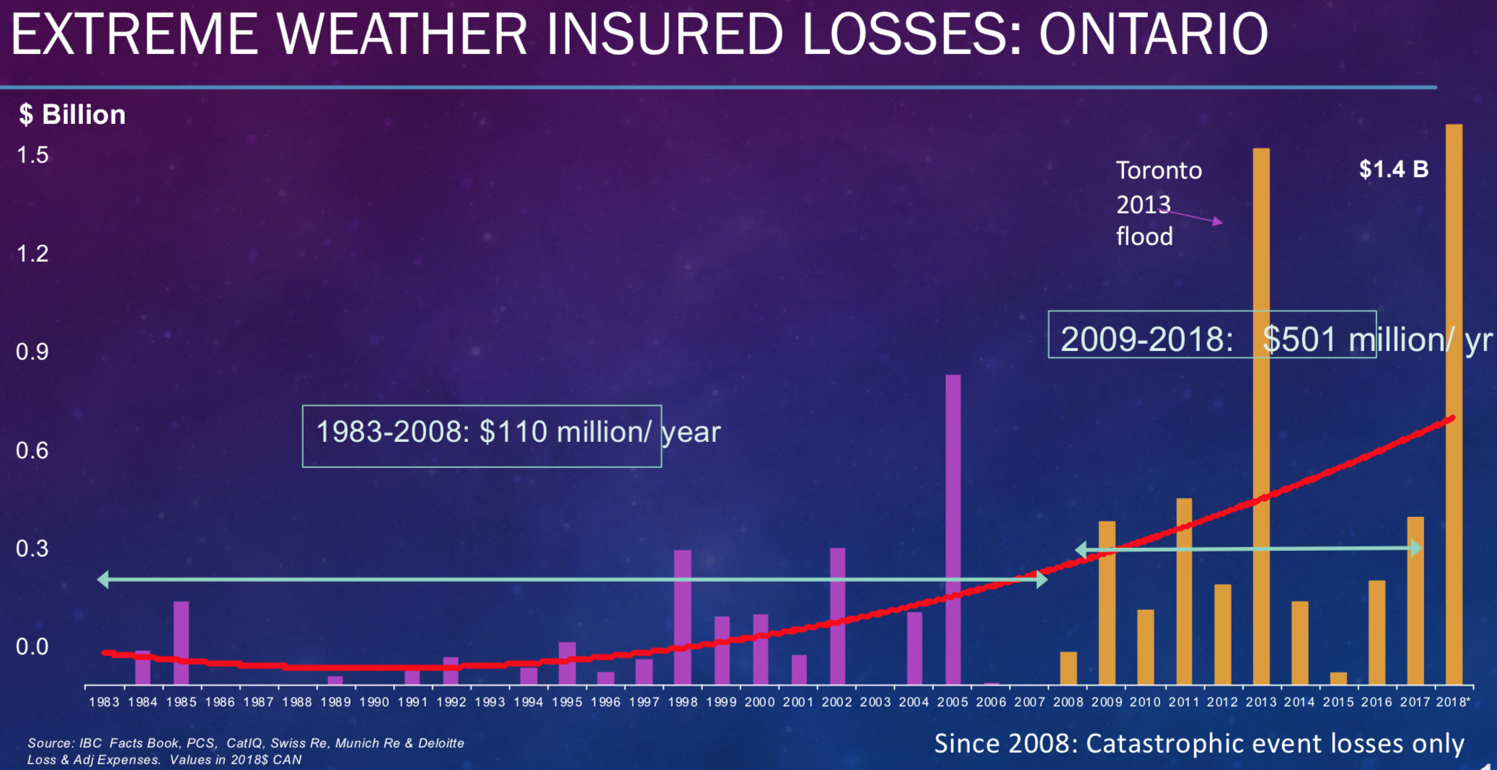
Notes:
This is private insurance.

Slide 12
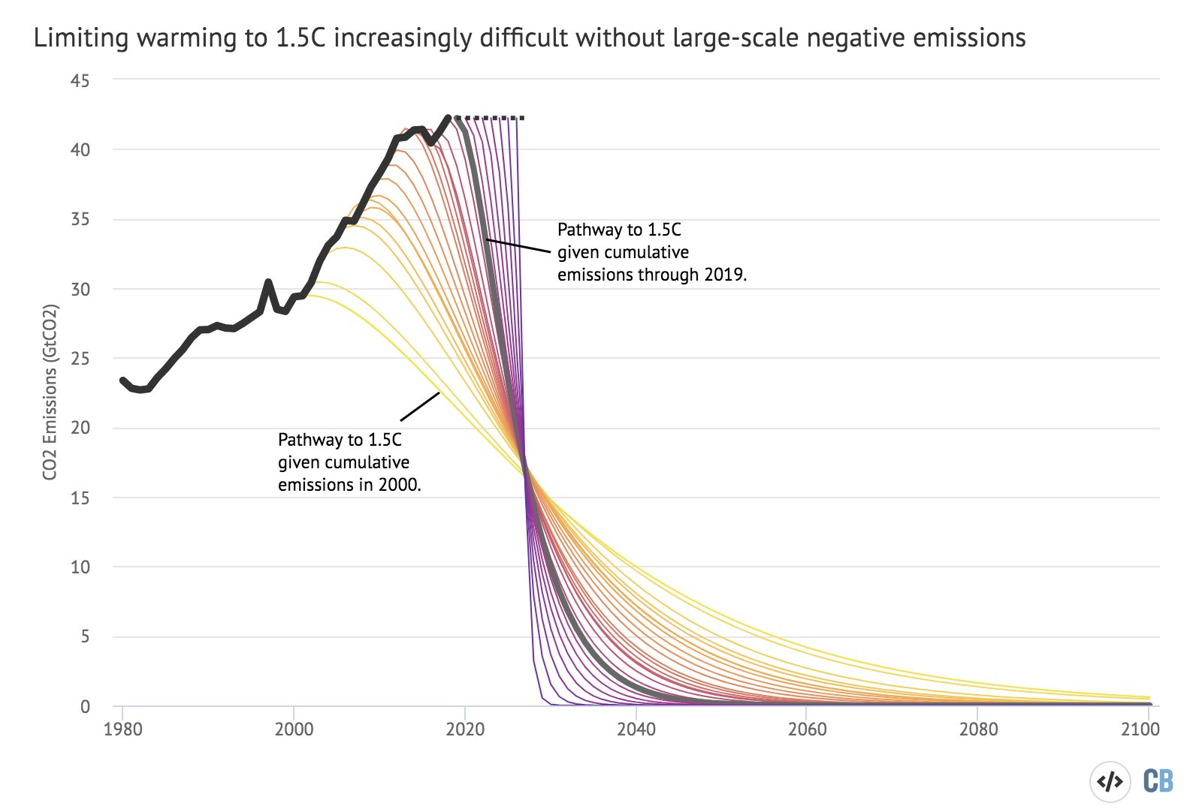
Source: Graph by CarbonBrief. Based on data from United Nations Environment Program (November 2019). Emissions Gap Report 2019.
Notes:
There is a way out of this.
We have no choice but to cut off the root source of the problem - primarily fossil fuel combustion - but also land use changes, deforestation, and some industrial emissions.
First and foremost, we must rapidly transition our energy systems.
This graph shows the trajectory needed to keep warming below the 1.5 degree threshold. The longer we wait the harder it gets. This can’t be a ‘go slow’ approach.
A transition of this magnitude can’t come only from just government policy. It requires a substantial shift in where capital is invested. We must stop investing in new fossil fuel related infrastructure and shift into carbon free investments

Slide 13
Climate risks for retirement savings
Transition Risk
Legal & Regulatory Risk
Portfolio Risk
Notes:
With that climate science refresher out of the way - I want to really focus in on the types of financial risks that climate change causes.
These are the ways in which the climate crisis will impact (and is already impacting) retirement savings.
Three buckets of climate risk we will cover quickly.
In each category - there are risks to value of investments that pension funds make, as well as long-term risks to the growth of those investments over time.

Slide 14
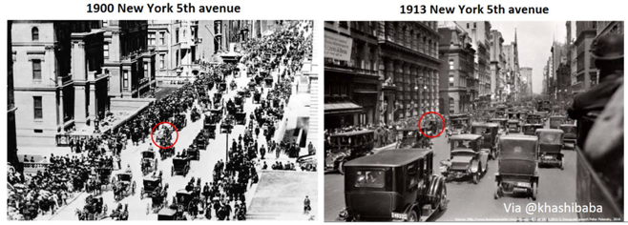
Transition Risk
Source: Khasha Ghaffarzadeh, via Twitter (10 October 2017).
Notes:
Technological disruption.
The above photo is an excellent example of technological disruption in action. The first photo shows 5th avenue in 1900 – everyone is on horses – with just one car visible. Just 13 years later, the entire street is dominated by cars with just one horse visible. You can probably think of other more recent examples of technological transition in your own lives.
Does anyone here still use film cameras? Kodak shareholders had a very rough ride over the past 25 years. The same for anyone who might have owned shares in blockbuster video before netflix came along.
This type of disruption is exactly what is happening today with a number of clean energy technologies - electric vehicles, with renewable energy, with energy storage, and with energy efficiency.
Sectors such as electric utilities, vehicle manufacturers, oil, gas and coal are facing unprecedented transition risks. These companies are a very large part of our economies and are widely held by pension funds. Many in the financial sector are blindly assuming that the transitions in these sectors will be smooth and gentle, but in reality most disruptions of this nature are not. The photo here illustrates it well. In 1900 - people assumed that cars were a small niche product that would increase slowly over time, but just 13 years later, cars had entirely replaced horses.
The technologies involved in the climate –related energy transition are mid-way through a massive disruption.
Carbon bubble.
The valuation of fossil fuel companies is largely based on their proven reserves of coal, gas, or oil. The climate crisis means that significant percentages of these reserves can never be extracted. That means that many fossil fuel companies are highly overvalued by the market. It’s a bubble - one quite similar to the bubble in housing prices in the United States that burst in 2008 which caused our last great financial crisis.
Mark Carney, former governor of the Bank of Canada and current governor of the Bank of England has repeatedly warned that these disruption risks pose a substantial risk to the stability of our financial system.

Slide 15

Transition Risk
Source: Reddit. Blockbuster < Netflix
Notes:
Technological disruption.
The above photo is an excellent example of technological disruption in action. The first photo shows 5th avenue in 1900 – everyone is on horses – with just one car visible. Just 13 years later, the entire street is dominated by cars with just one horse visible. You can probably think of other more recent examples of technological transition in your own lives.
Does anyone here still use film cameras? Kodak shareholders had a very rough ride over the past 25 years. The same for anyone who might have owned shares in blockbuster video before netflix came along.
This type of disruption is exactly what is happening today with a number of clean energy technologies - electric vehicles, with renewable energy, with energy storage, and with energy efficiency.
Sectors such as electric utilities, vehicle manufacturers, oil, gas and coal are facing unprecedented transition risks. These companies are a very large part of our economies and are widely held by pension funds. Many in the financial sector are blindly assuming that the transitions in these sectors will be smooth and gentle, but in reality most disruptions of this nature are not. The photo here illustrates it well. In 1900 - people assumed that cars were a small niche product that would increase slowly over time, but just 13 years later, cars had entirely replaced horses.
The technologies involved in the climate –related energy transition are mid-way through a massive disruption.
Carbon bubble.
The valuation of fossil fuel companies is largely based on their proven reserves of coal, gas, or oil. The climate crisis means that significant percentages of these reserves can never be extracted. That means that many fossil fuel companies are highly overvalued by the market. It’s a bubble - one quite similar to the bubble in housing prices in the United States that burst in 2008 which caused our last great financial crisis.
Mark Carney, former governor of the Bank of Canada and current governor of the Bank of England has repeatedly warned that these disruption risks pose a substantial risk to the stability of our financial system.

Slide 16
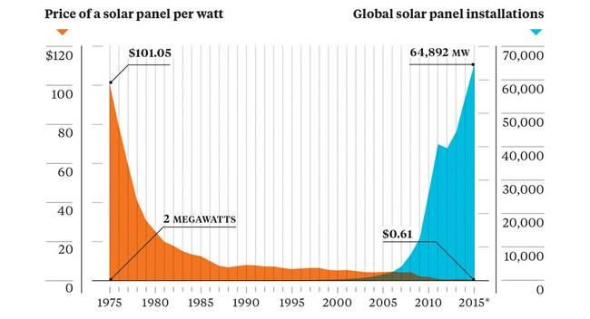
Source: Earth Policy Institute / Bloomberg. (2015).

Slide 17
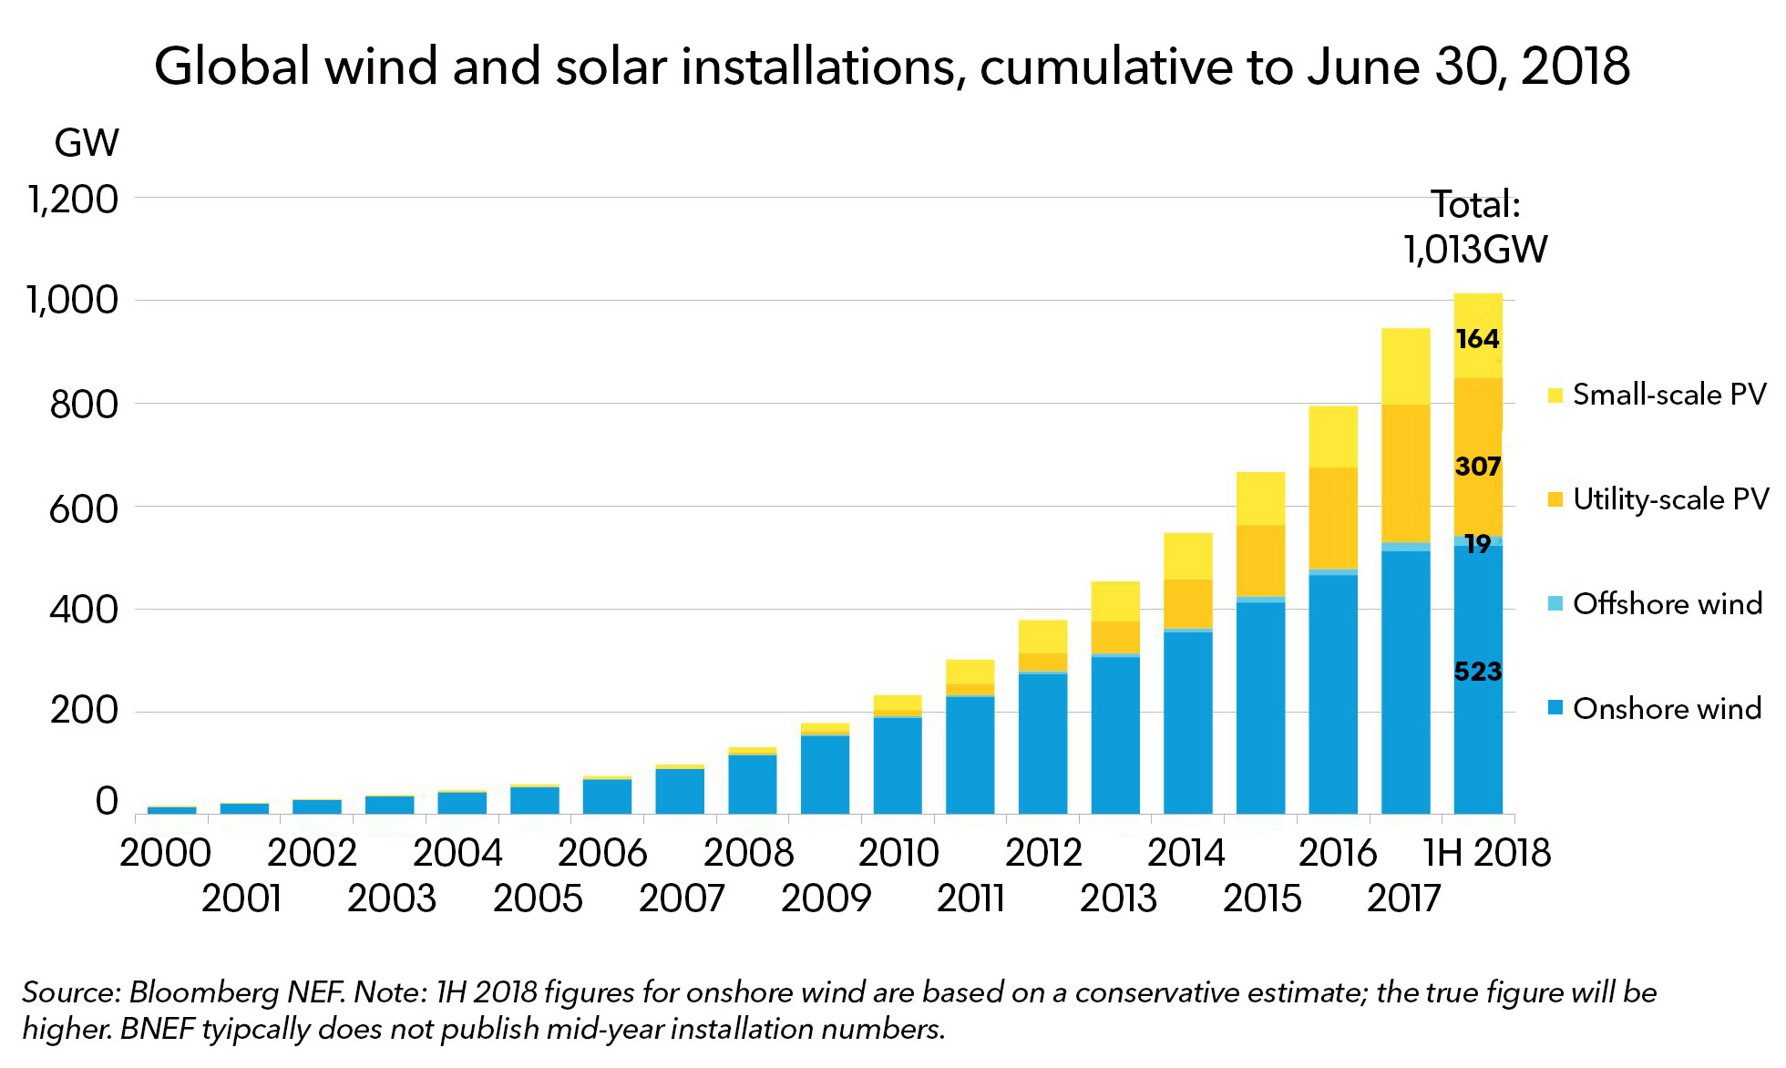

Slide 18
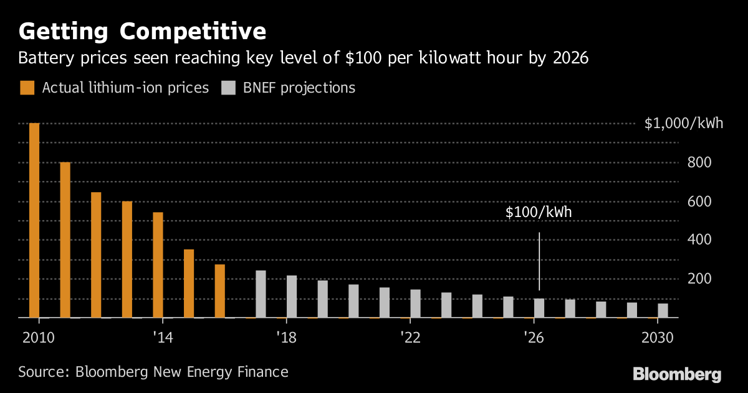

Slide 19
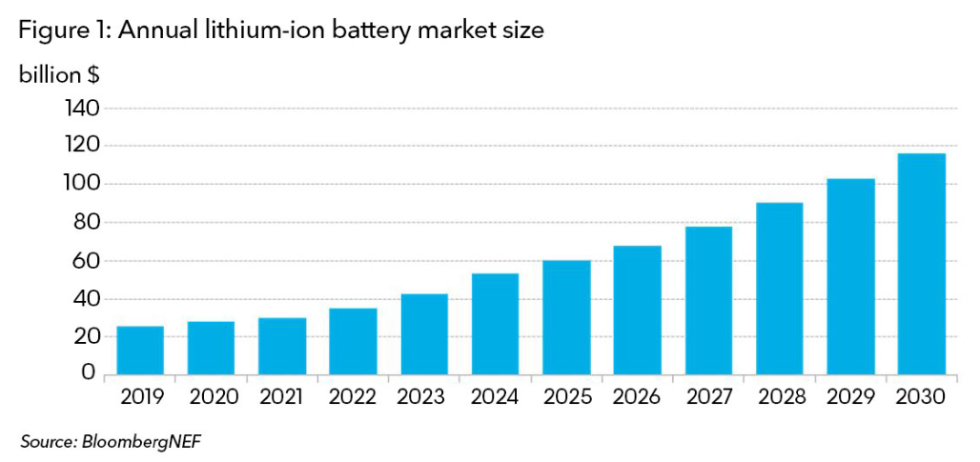

Slide 20
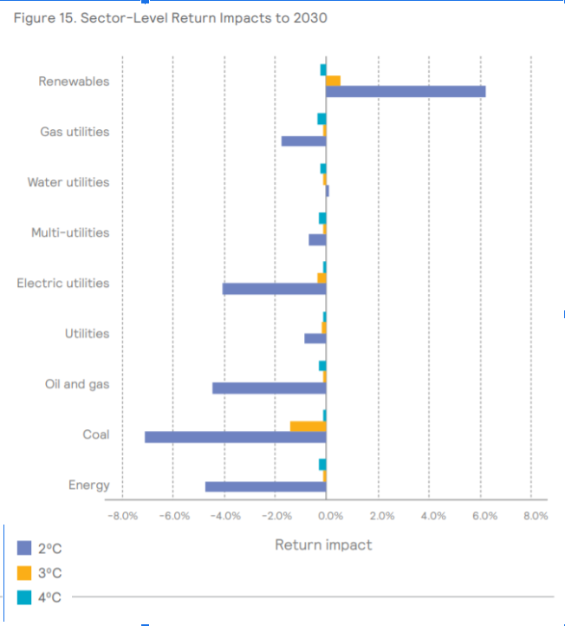
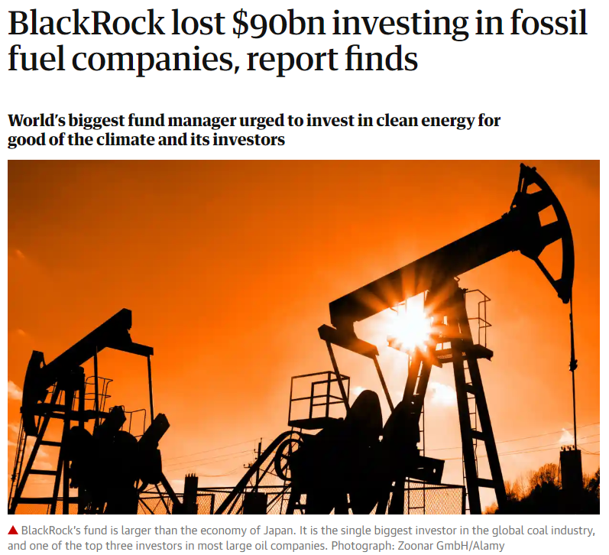
Transition Risk
Source: Mercer - Investing in a Time of Climate Change: The Sequel 2019.

Slide 21


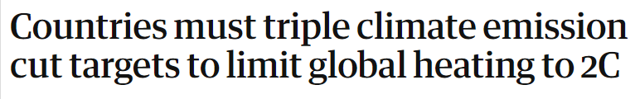
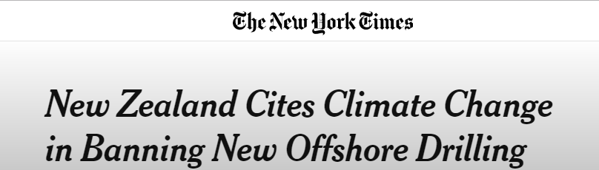
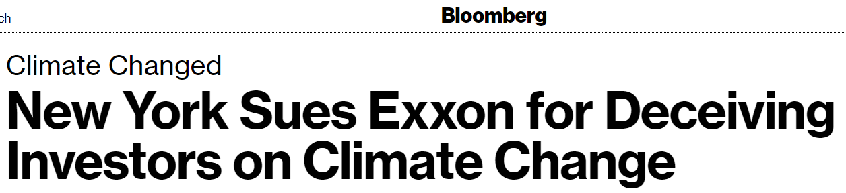

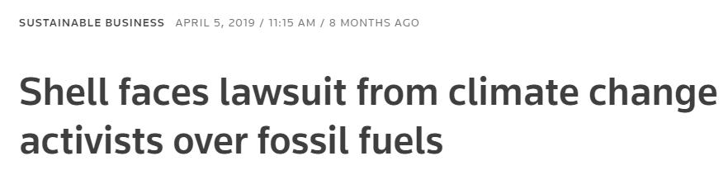
Legal & Regulatory Risk

Slide 22
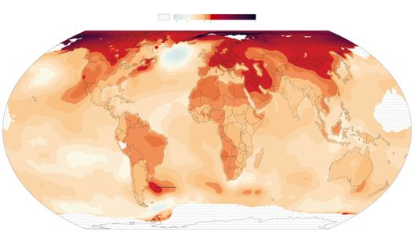
Portfolio Risk
Notes:
Many asset managers will tell you that they are well aware of transition risk and regulatory or legal risks and have systems in place to manage these risks. While evidence shows that most managers are not actually on top of these financial risks, we are seeing that many asset managers are thinking about this and are starting to respond.
However, the largest long-term risk from climate change to your portfolio doesn’t come from the energy transition or from regulation or legal challenges. The largest risk to your retirement comes from climate change itself.
The entire global economy is a risk from climate disruption. In real terms – the economic growth that we are all relying on to grow our investments over time and pay for our retirement could be impacted by the impacts of climate chaos.
The collapse of the interconnected food system. Wide-scale water shortages. Mass migration. And of course the rapidly accelerating cost of climate related disasters are a drag on economic growth. Economists have already shown that climate chaos is a drag on GDP.
Unless major policy changes are made to meet the Paris Goals, the U.S. is expected to see its GDP per capita decline in real terms from climate related economic disruption.
Climate risk needs to be considered in UK?

Slide 23
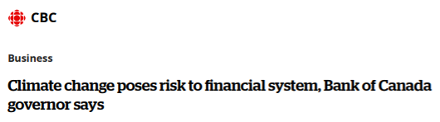

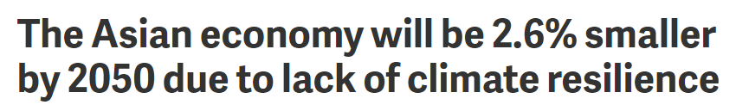
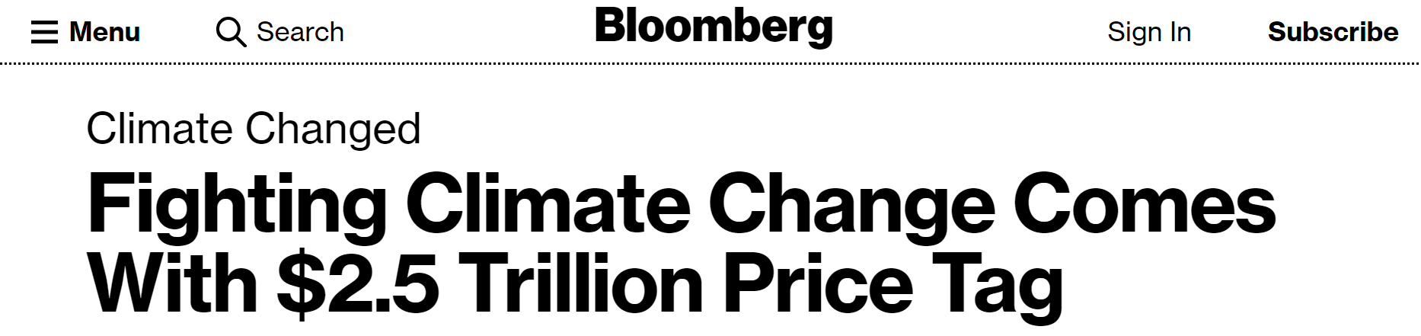
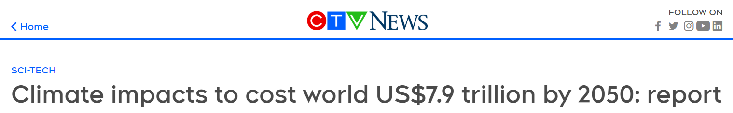

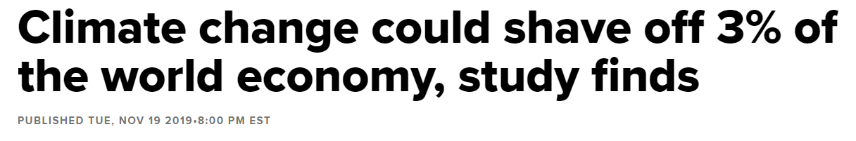
Portfolio Risk
Notes:
Many asset managers will tell you that they are well aware of transition risk and regulatory or legal risks and have systems in place to manage these risks. While evidence shows that most managers are not actually on top of these financial risks, we are seeing that many asset managers are thinking about this and are starting to respond.
However, the largest long-term risk from climate change to your portfolio doesn’t come from the energy transition or from regulation or legal challenges. The largest risk to your retirement comes from climate change itself.
The entire global economy is a risk from climate disruption. In real terms – the economic growth that we are all relying on to grow our investments over time and pay for our retirement could be impacted by the impacts of climate chaos.
The collapse of the interconnected food system. Wide-scale water shortages. Mass migration. And of course the rapidly accelerating cost of climate related disasters are a drag on economic growth. Economists have already shown that climate chaos is a drag on GDP.
Unless major policy changes are made to meet the Paris Goals, the U.S. is expected to see its GDP per capita decline in real terms from climate related economic disruption.
Climate risk needs to be considered in UK?

Slide 24
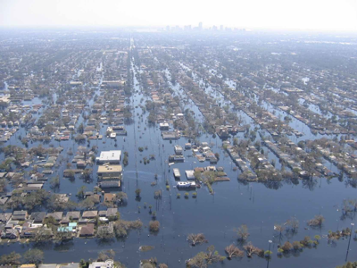
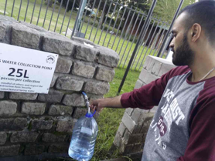
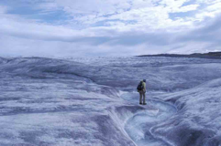
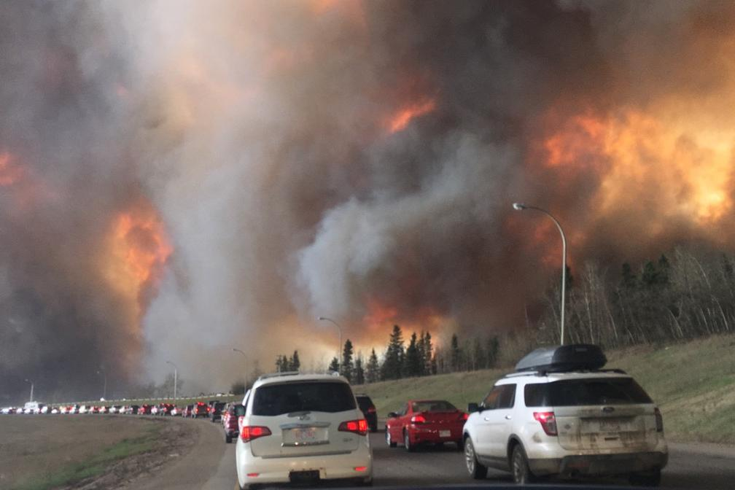
Notes:
Here are some recent concrete examples of real economic impacts from climate change:
Houston flooding from Hurricane Harvey
Cape town water shortages
Columbia Glacier - water tower to the prairies
Fort McMurray fires - caused massive industrial disruption, burned 10% of the city, ongoing social and economic impacts.

Slide 25
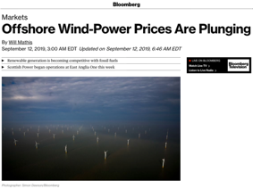
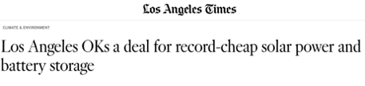
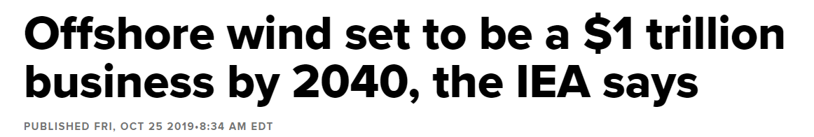
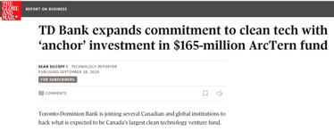
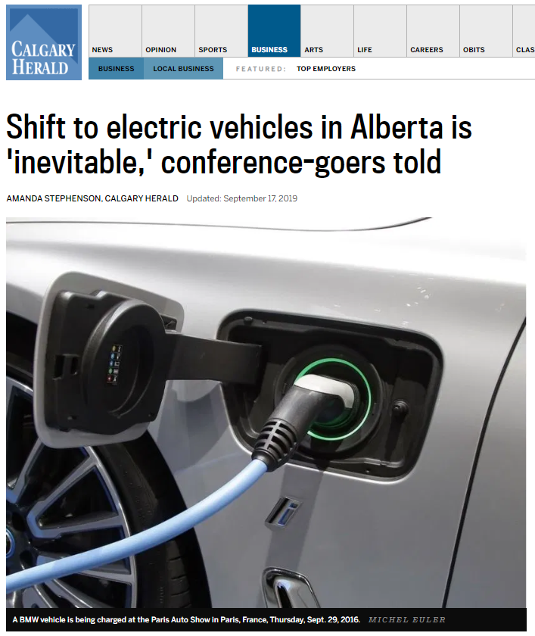
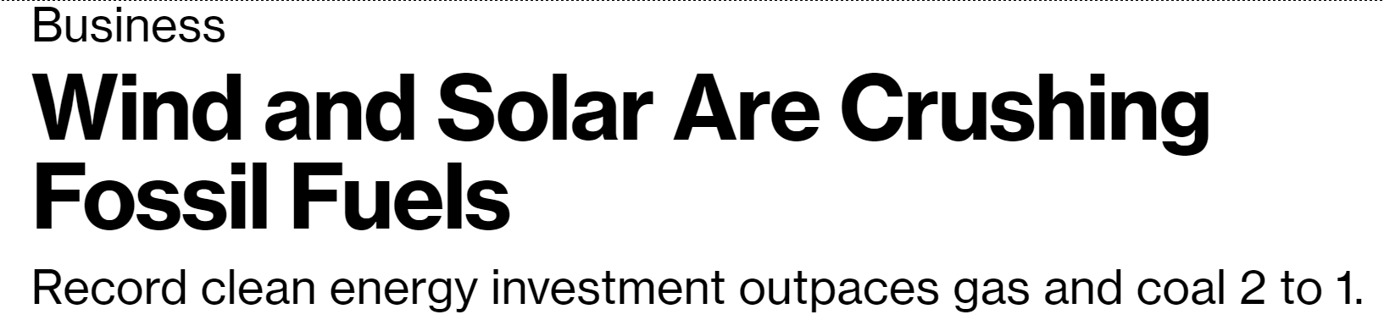
Changing Climate Risk to Opportunity
Notes:
The technological disruption I discussed earlier has a major flipside. Solutions to the climate crisis are expected to be some of the fastest growing sectors of our economic in the coming decades.
These opportunities exist all over now, but the financial system isn’t well setup to find them.
examples:
Net zero buildings - energy retrofits for existing buildings and extremely efficient new buildings.
The electrification of transportation - buses, trains, trucks
Profitable, low-cost renewable energy.
Energy storage
New clean technologies of all types.

Slide 26
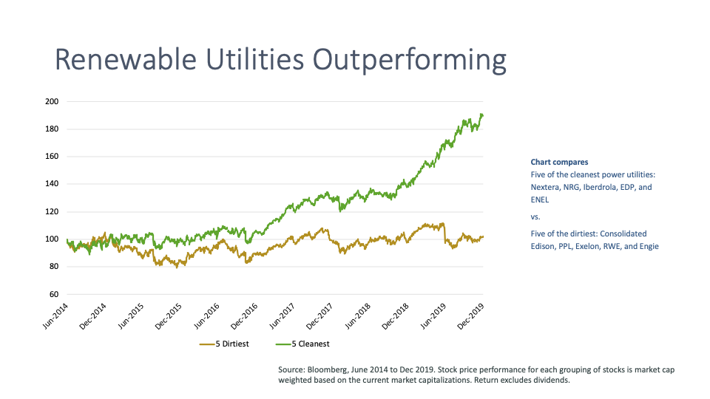

Slide 27
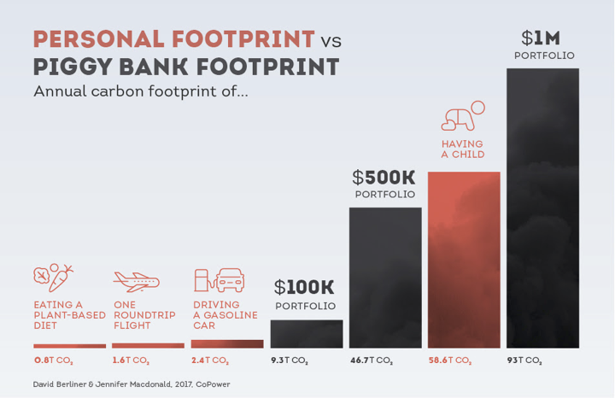
Notes:
As I’ve mentioned before - engaging your pension fund on climate change is one of the most important actions an individual can make to help to address this crisis. This graphic from COPOWER - a company which creates green bonds - illustrates the carbon footprints of various actions.

Slide 28
Investment Strategies
Traditional investment | Responsible investment | Thematic investment | Impact investment | Philanthropy
Limited or no focus of ESG factors of underlying investment analysis and execution. | ESG risks are integrated into analysis of all holdings, as a component of financial risk management. Negative and positive screening of ESG risks is used to align a portfolio to specific values. | Focus on or more issue areas where social or environmental need creates commercial growth opportunity for market-rate returns. | Focus on or more issue areas where social or environmental need may require some financial trade-off. | Social enterprise funding in a variety of forms, with a range of return possibilities.
COMPETITIVE RETURNS
ESG RISK MANAGEMENT
ESG OPPORTUNITIES
Source: Desjardins. Adapted from Bridge Ventures, Sustainable Impact Investments : How we define the markets, 2012
Notes:
The different strategies we see here can also be viewed as a timeline of responsible investments.
Strategies at first were very basic – e.g. exclusions – but managers added more sofisticated strategies as evaluation and monitoring tools improved.
Thematic investments : We select top companies in sectors that are directly related to an ESG theme
For example, the SocieTerra Cleantech Fund invests in companies whose core business is to come up with specific solutions to the biggest environmental issues facing our planet.
Active OwnerShip
Companies selected for the RI portfolios are also subject to our shareholder engagement policies. As shareholders, we will work with management teams to influence the companies through open and direct dialogue, exercising voting rights and through submitting proposals designed to improve the companies positioning from a variety of Societal, Governance or Environmental perspectives.

Slide 29
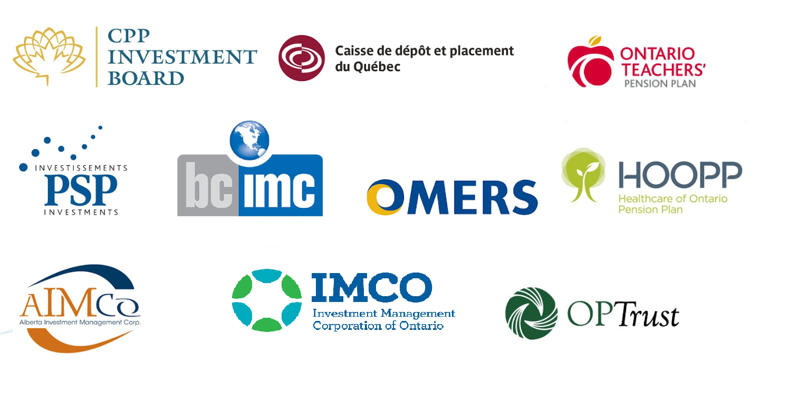
The Canadian pension model
Notes:
So before we go further - it’s probably a good idea to quickly talk about how pensions plans typically work.
The exact structure varies widely - but at a high level they are all much the same.
Your employer collects a small percentage of your wages and puts them into a pooled saving fund. Most often, those funds are matched in some way by your employer - if you are employed by a private company this comes out of the company revenue. If you are employed by a government, they make the contribution.
These pooled funds are invested in a variety of ways. The so called ‘Canadian model’ of pension investment involves hiring a dedicated team of financial professionals with no link to the employer to actively manage (try to beat market) the investments. They use a variety complicated and sophisticated investment tools - which we won’t get into in detail here.
The money you put away each year, isn’t actually enough on its own to pay for your eventual pension. To get enough funds to do that, the money needs to grow each year - earning compound interest. So not only does the value of your pension need to be maintained, but it needs to grow as well. If it doesn’t - the pension plan can face a shortfall and have trouble paying out pensions in the long-run.
Your pension isn’t just sitting there, but these assets are invested in real companies.

Slide 30






What’s your pension fund invested in?

Slide 31
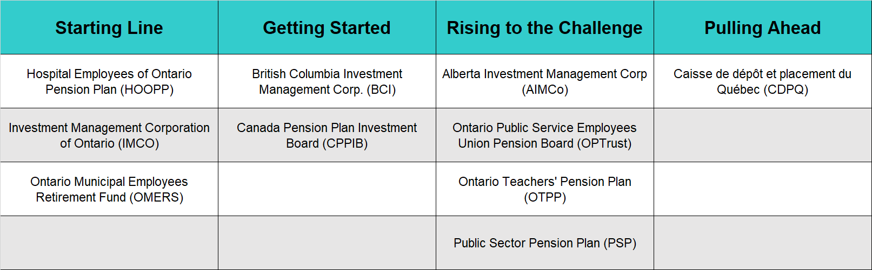
How are Canada’s Pensions Preparing?
Notes:
No Canadian Pension Plan has demonstrated a good handle on climate risk and solutions yet.
There isn’t a lot of time left for them to come up with a comprehensive strategy.
And here is a core problem. These funds don’t have clear, stated goals on climate change.
We want them to commit to a timeline for understanding the climate risks in their portfolios, and we want clear timelines for increasing investments into profitable climate solutions.

Slide 32
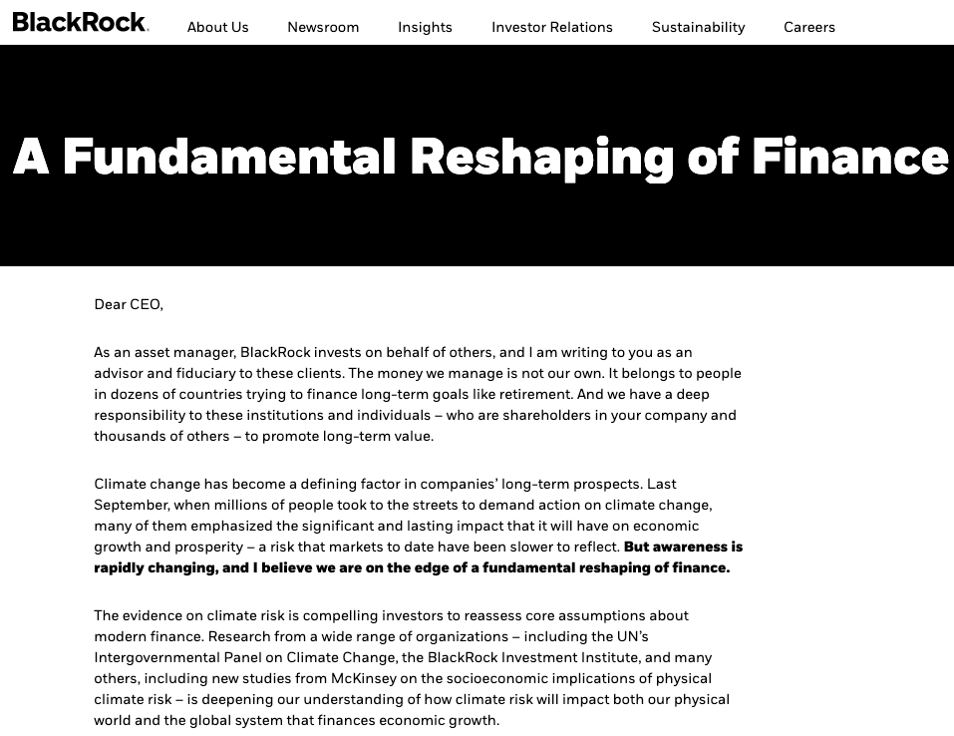
Notes:
On January 14th, Larry Fink, the CEO of Blackrock - the world’s largest money manager and institutional investor - published a letter to his clients explaining how the company was pivoting to put climate risk at the centre of it’s investment strategy.
“Indeed, climate change is almost invariably the top issue that clients around the world raise with BlackRock.”
Until this moment, Blackrock has been considered a laggard on climate and sustainability. This letter is seen as a monumental change in the culture of leading institutional investors in taking the existential risks of climate change seriously.

Slide 33
Engaging Your Pension
Who Can Engage?
Individuals
  any Canadian can engage CPPIB
Labour representatives
Plan Trustees
Plan sponsors
Notes:
Take a pause - how is everyone feeling? Questions before I move on?
Pension plans work for you. They are experts, hired by you, your union, and your employer to grow your retirement wealth at the lowest possible risk. They like to be left alone to do this. They don’t like to be told how to do their jobs, and they are resistant to opening that door.
But - thoughtful constructive, engagement from beneficiaries can have a huge impact on how they operate.

Slide 34
Engaging Your Pension
Send a letter using Shift’s online action tool: https://www.shiftaction.ca/take-action
Follow up with constructive, pointed questions
Work through the governance structure of your union (trustees, reps, sponsors)
Schedule a meeting with your pension managers
Attend Annual General Meetings
File regulatory complaints
Public communications (letters to the editor, op-eds)
Notes:
Pension plan activities can be complicated - so you generally want to avoid trying know more than the pension fund does.
What works best for initial rounds of engagement are questions.
What do you own. (they have to tell you)
How are you managing climate risk?
What are your (measurable) goals?
*just this week - asset owners - including pensions (cdpq) committed to 2050 carbon neutrality consistent 1.5 degree limit.
Repeat the cycle…
Create incentives for fund managers to do the right thing - their jobs, their pay, their personal and public profile should be tied to success on climate.

Slide 35
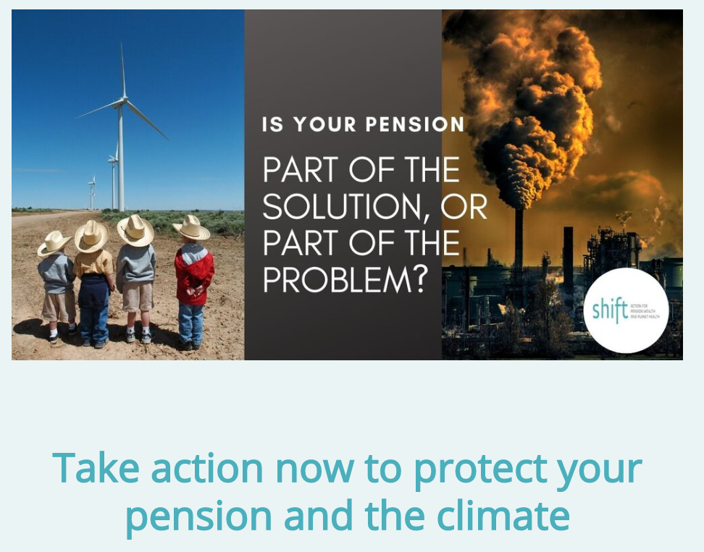
www.ShiftYourPension.ca
Notes:
shiftaction.ca

Slide 36
Thank you
Notes:
Questions:
What about Divestment?
ESG:

