Slide 1
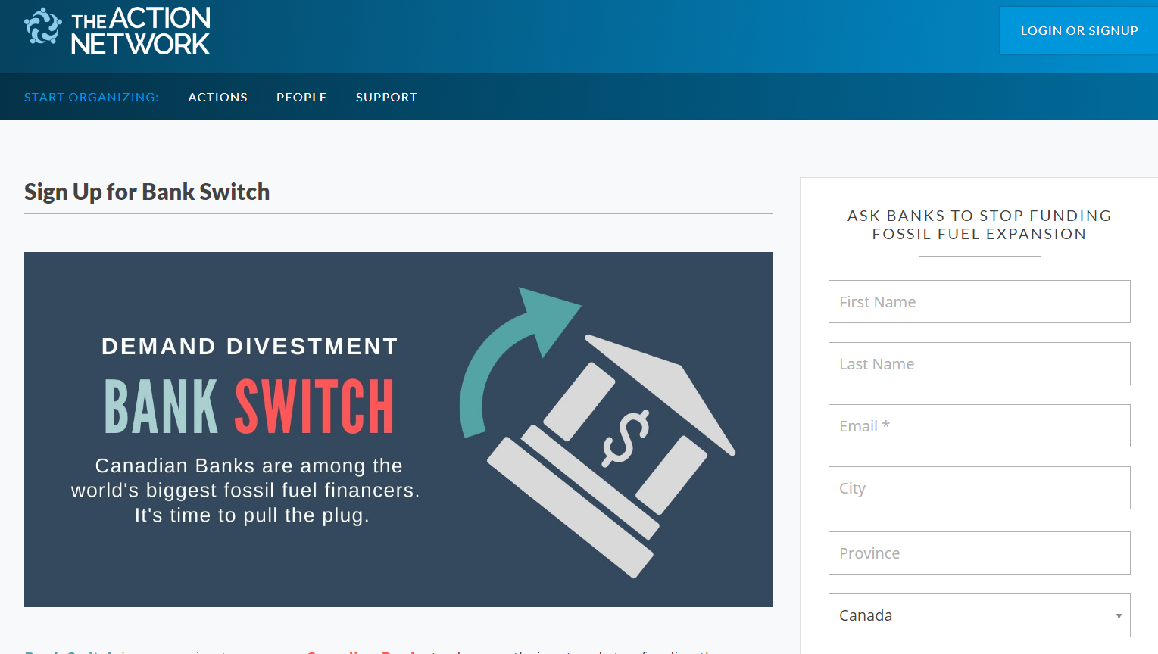
BankSwitch
Workshop
The Big 5 Canadian Banks
and the Tar Sands

Slide 2
Workshop
Overview
PART 1: CONTEXT
PART 2: BANKSWITCH
PART 3: Q and A
Fossil Fuel Production and Expansion
The Big 5’s Fossil Fuel Funding
Existing Alternatives
Our Plan
Why we designed it this way
What you can do
Thoughts? Ideas? Questions?
Let’s brainstorm!
Notes:
I’m making a few cases here, why and how this will work and why and how this is perhaps the best campaign to put your efforts into right now.

Slide 3
CONTEXT:
Fossil Fuel Production and Expansion

Slide 4
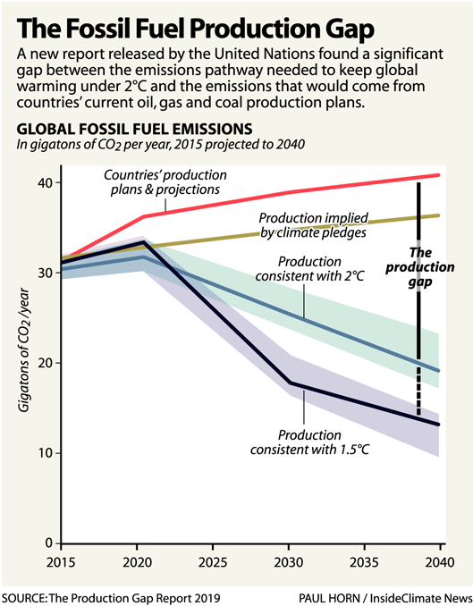
The Production Gap
Notes:
http://productiongap.org/

Slide 5
3 Main Types of Fossil Fuel Reserves
(Depleted Reserves)
Developed Reserves
Proven Reserves
Potential Reserves
(Unknown Reserves)
Notes:
Depleted - different companies handle these, sometimes they are worth processing if prices are high
Developed Reserves - We probably can’t stop these, we may even need them to keep people from suffering
Proven Reserves - These are the ones we need to prevent from being developed AND the ones oil companies will fight hardest to develop
Potential Reserves - These also have to be stopped, but may not fight as hard since they aren’t assets in the same way, but they are kind of assets and companies will likely fight for them if they have bought the rights etc.

Slide 6
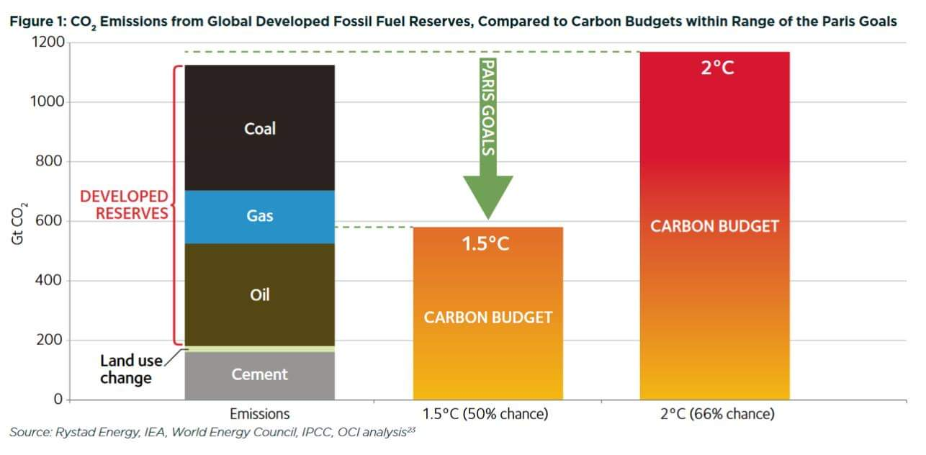
Global Carbon Budget

Slide 7
Preventing
Fossil
Fuel
Expansion
Divestment campaigns are awesome, but don’t hit balance sheets or operations directly.
So let’s target the lenders!
Notes:
Physically blocking oil expansion is awesome, but it’s not for everyone. In a way, this is a kind of support we can provide for lend protectors, by cutting off the funding of the companies they are fighting.

Slide 8
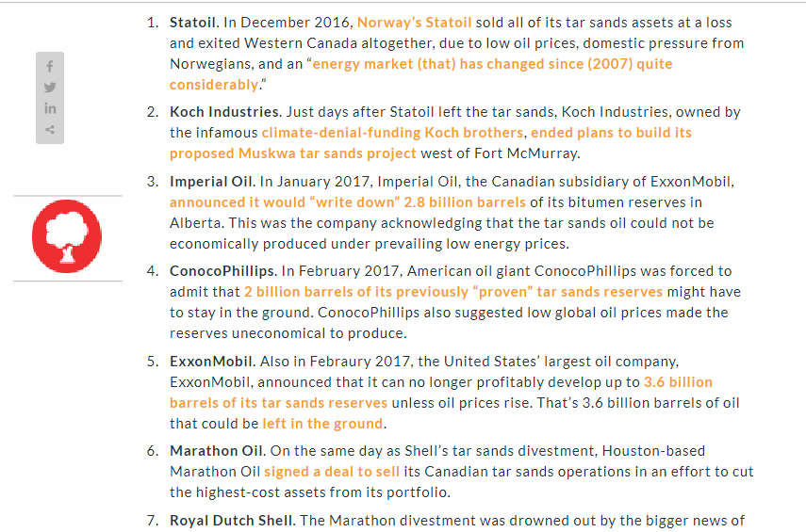
The oil sands are struggling to find funding.
Let’s kick them while they’re down.
Prices are low and costs are high!
Tar Sands have very high CO2 intensity
Global oil companies are pulling out…
Notes:
Intensity is because it takes a lot of energy to get the oil out of the sand and that is often provided by natural gas. Sometimes they burn more units of energy than they get out of the process!!
This is from and EDF report from 2017! And the news was pretty bad again this year, times of ‘assets’ written off in the tar sands as too expensive to produce!

Slide 9
Just Transition:
What happens to Canadian oil workers?
Oil isn’t coming back.
CAPP and other similar groups are about protecting ASSETS (proven reserves) not jobs.
Oil workers best bet is big investment in Geothermal and remediation.
BankSwitch could help them rather than hurt them if it creates future-proof jobs in Canada.

Slide 10
CONTEXT:
How the Big 5 are Funding the Climate Apocalypse

Slide 11
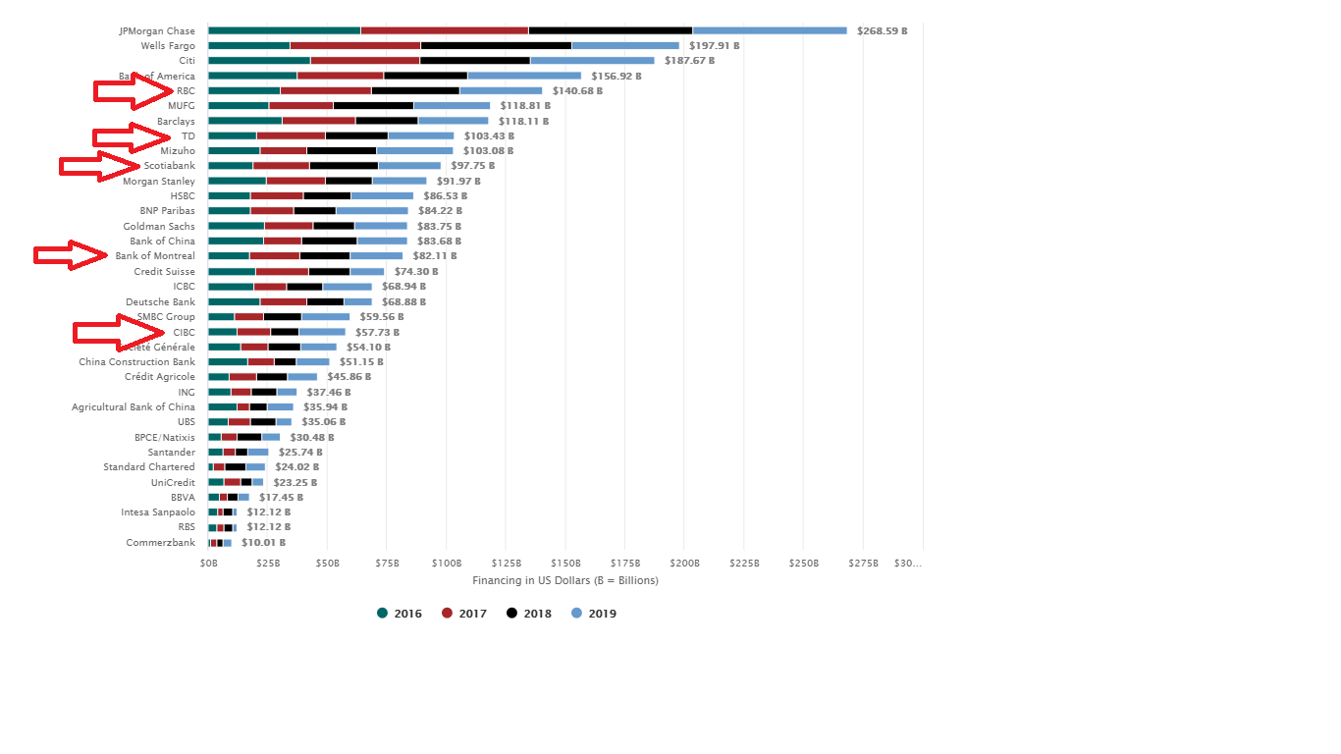
Global Ranking Total Investment
Lots more info available in the Banking on Climate Change Report from Rainforest Action Network and BankTrack.
https://www.ran.org/bankingonclimatechange2020/
Notes:
ON SCREEN: Compare total assets and things look even worse for Canadian banks. (TALK ABOUT LIBERAL POLICY HERE and TMX. There are no Votes for Liberals in Alberta)

Slide 12
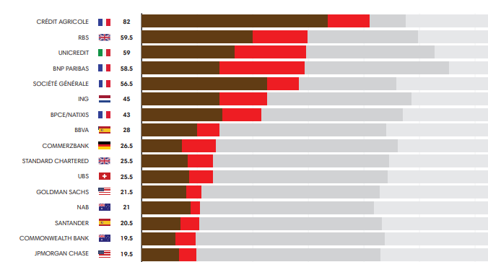
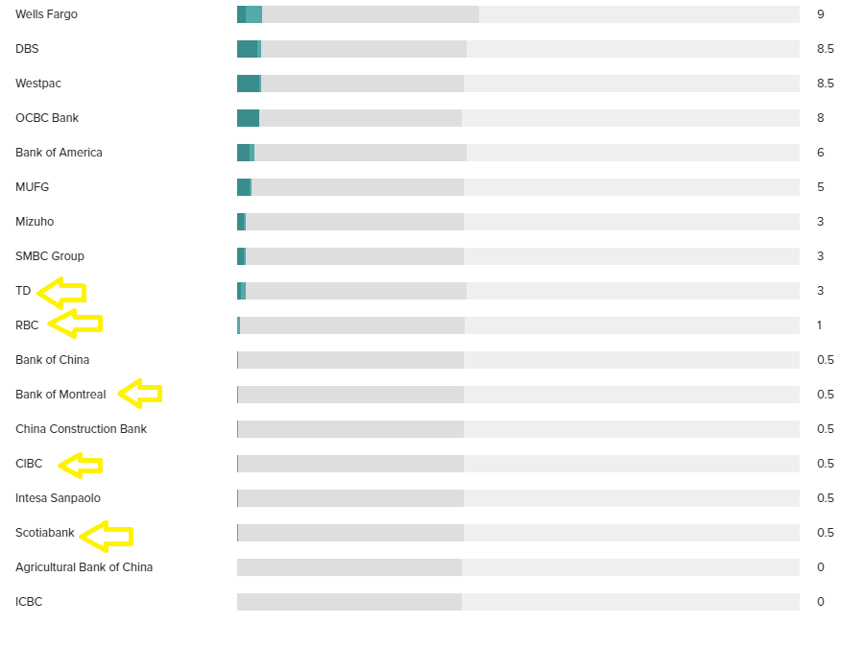
Global Ranking Policies
Notes:
Horrifically bad

Slide 13
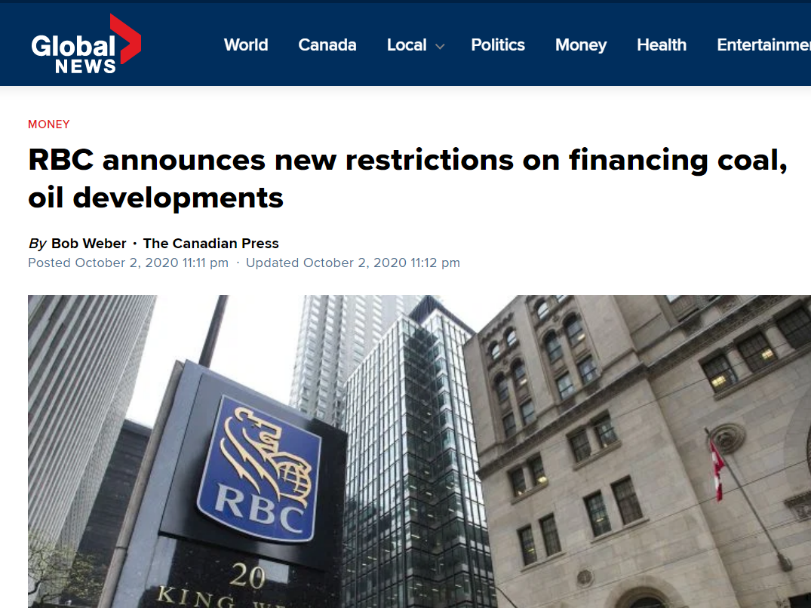
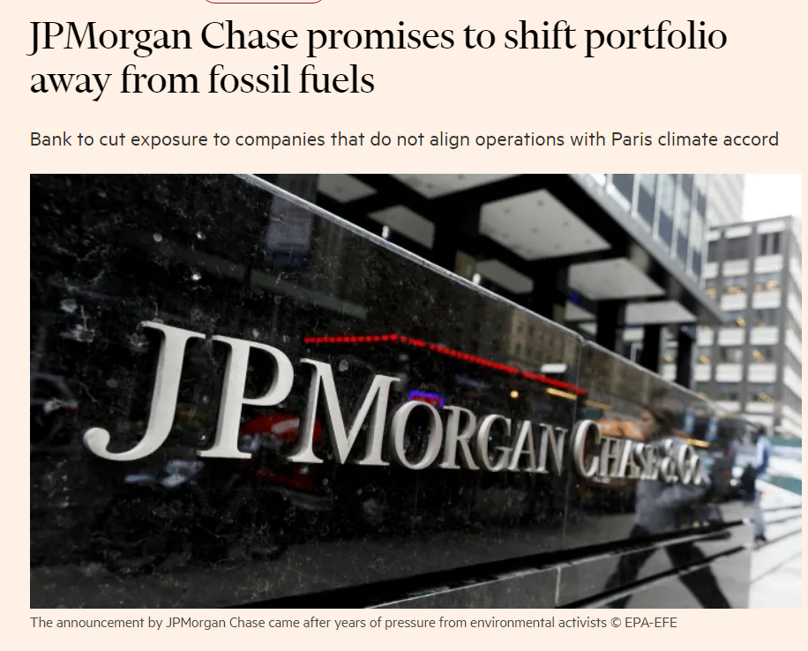
The Banks are starting to feel the pressure.
Grow the Record, Stop the Money Pipeline, Fossilbanksnothanks (Toronto350 has been working tirelessly on this)
US banks like Chase have started making big announcements.
RBC, which is the biggest fossil investor and has been the focus of many protests also made a baby step in their coal policy with a lot of fanfare about it.

Slide 14
CONTEXT:
Existing Alternatives

Slide 15
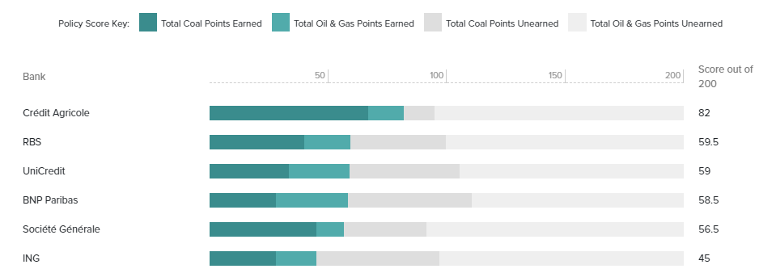
There is No
Good National Alternative
5-way monopoly is a problem: Tangerine is now owned by Scotiabank not ING.
Notes:
This is the hardest part of the campaign. And part of why we have encouraged people to threaten to move on a future date in the hopes of getting one the big 5 to clean up their policies, rather than actually getting people to start moving their money like some similar campaigns in the past. Getting a policy change out of big five is also a bigger impact.
In a way this is both the problem and the reason this is o important, if one switches, you have a real competition, but they all want to be the same, so if one switches, they probably all will.

Slide 16
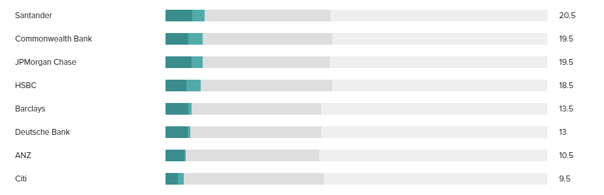
Semi National Options?
National Bank? (Tiny bit better)
Desjardins? (Tiny bit better)
HSBC? (Slightly better)
Notes:
HSBC gets a significantly better score in the reports, but still has more money in fossil fuels than CIBC does.
National Bank (signed the UN Declaration, otherwise not way better, for example they were one of many underwriters for TMX in 2017 for example)
Desjardins (a mega credit union, but honestly not great, they have pipeline loans, it was a major campaign to get them to divest even their ethical funds...)

Slide 17
Regional Credit Unions
ONTARIO
Alterna
Duca
Kindred
QUÉBEC
National and Desjardins offer more service here
Many smaller credit unions
BRITISH COLUMBIA
Vancity
CCEC
ATLANTIC and PRAIRIES
Small credit unions
Notes:
DUCA Financial has ensured us in writing that they don’t have any loans funding fossil fuel expansion — although they couldn’t guarantee that they didn’t have small business loans for oil and gas services companies.
Kindred is a small Christian credit union in Kitchener that really seems to put ethics first. They are more focused on divestment from weapons companies — but that’s not a bad thing!
Alterna has confirmed to us that they do not have any commercial loans to the fossil fuel industry and we are waiting to hear back about their policies regarding future loans.

Slide 18

My Experience with Alterna
Notes:
Ask Chat if anyone is already with a credit union.

Slide 19
OUR PLAN
How it Works

Slide 20
Contact your
branch manager NOW!
Switch in April.
The first step is pretty easy!
April is AGM season for the big 5.
If your bank makes meaningful policy announcements -- maybe you don’t have to switch.

Slide 21
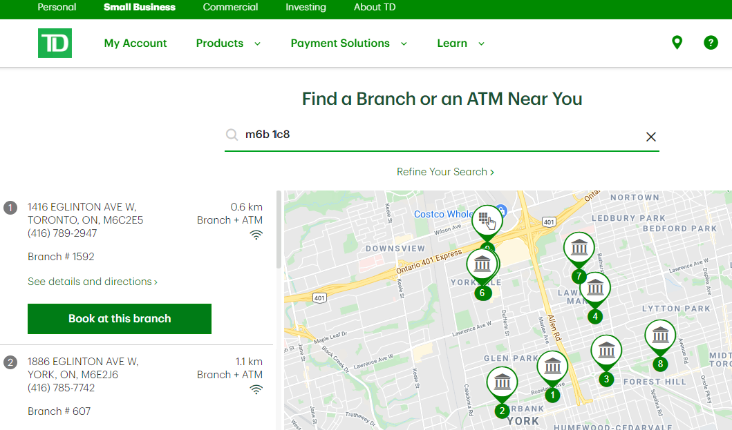
How to contact your Branch Manager
Look! A handy-dandy Evil-o-graph!
It depends on the bank.
At TD, I booked an appointment with a client services rep in my branch and then hand them forward an email to the branch manager.

Slide 22
Sign-up
on Action Network
This list gives us leverage.
It will be appealing to the bank’s client acquisition teams. (WE WON’T SELL IT! But we will give our own critical recap of any policy announcements)
It makes the campaign newsworthy if it gets BIG ENOUGH.
Notes:
Put link in chat.

Slide 23
The “Demands”
The Formal Demands are from BankTrack:
publicly clarify your position on the relation between climate change and the extraction and burning of fossil fuels
publicly commit to immediately end your support for all new fossil fuel projects, including exploration, extraction, transportation and power
publish a robust plan for phasing out your support for all existing fossil fuel projects and companies on a timetable consistent with what is necessary to meet the Paris targets.
But there is a lot of room for you to determine what is ‘enough’ -- maybe you have additional demands.

Slide 24
OUR PLAN
Why It Works

Slide 25
No Institution
is a
Monolith!
This is one reason we are targeting branch managers - to get the maximum number of people talking about it within the bank, all of whom will have different views of politics and climate change.
Fossil fuel investments have been losing tons of money lately - so some people in the bank will want to drop them just for financial reasons.
The larger our list gets, the more appealing climate policy will be to people in marketing and client acquisition departments.
Notes:
Activists forget this
Talk about Kent

Slide 26
We are using the banks’ structure against them.
Branch managers and people under them are incentivized by sales and number of accounts.
Loss aversion.
Making them COMPETE!
Notes:
-- they don’t care what protestors or credit unions do, we are too small -- but imagine if one of the big 5 decided to actually clean up their act and put money into marketing that decision and making it easy for people to switch! Now that would scare they other banks!

Slide 27
Also targeting small institutions to move their finances.
Again, this will hit a different group of client services people in the bank and get more people talking about fossil fuel policies.

Slide 28
What you can do!

Slide 29
Simple ways to help!
(I can’t do this on my own)
Sign-up (right now!)
Get 3 friends to sign up!
Postering
Get other climate groups to take this project on (in their own way)
Talk about it to friends in finance
Send me an email about your experience if you bank at Scotia, BMO, CIBC or RBC.

Slide 30
The best way to help!
Make a list of everyone you know who might be interested and contact them all asking them to:
1) sign-up
2) participate in a workshop like this
3) contact their own friends
Work your network!
Notes:
More than half the people who have signed up are people I know either friends and family or people I have developed a relationship with through climate activism. They sign up because they know me and they know I wouldn’t care about this if it weren’t important.

Slide 31
Thanks for listening!
Questions? Ideas?
Excitement!?

