Slide 1



Global Carbon Budget
2022
2022
The GCP is a Global
Research Project of
and a Research
Partner of
Published on 11 November 2022
PowerPoint version 0.93 (7 November 2022)

Slide 2
Acknowledgements
The work presented here has been possible thanks to the enormous observational and modelling efforts of the institutions and networks below
Atmospheric CO₂ datasets
NOAA/ESRL (Dlugokencky and Tans 2022)
Scripps (Keeling et al. 1976)
Fossil CO₂ emissions
Andrew and Peters, 2022
CDIAC (Gilfillan and Marland, 2021)
UNFCCC, 2022
BP, 2022
Consumption Emissions
Peters et al. 2011
GTAP (Narayanan et al. 2015)
Land-Use Change
Houghton and Nassikas 2017
BLUE (Hansis et al. 2015)
OSCAR (Gasser et al. 2020)
GFED4 (van der Werf et al. 2017)
FAO-FRA and FAOSTAT
HYDE (Klein Goldewijk et al. 2017)
LUH2 (Hurtt et al. 2020)
Atmospheric inversions
CarbonTracker Europe | Jena CarboScope | CAMS | UoE In situ | NISMON-CO2 | CMS-Flux
Land models
CABLE-POP | CLASSIC | CLM5.0 | DLEM | IBIS | ISAM | ISBA-CTRIP | JSBACH | JULES-ES | LPJ-GUESS | LPJ | LPX-Bern | OCN | ORCHIDEEv3 | SDGVM | VISIT | YIBs
Climate forcing CRU (Harris et al. 2014) | JRA-55 (Kobayashi et al. 2015)
Ocean models
CESM-ETHZ | FESOM-2.1-REcoM2 | MICOM-HAMOCC (NorESM-OCv1.2) | MOM6-COBALT (Princeton) | MPIOM-HAMOCC6 | NEMO3.6-PISCESv2-gas (CNRM) | NEMO-PISCES (IPSL) | NEMO-PlankTOM12
fCO₂ based ocean flux products
CMEMS-LSCE-FFNNv2 |CSIR-ML6 | Jena- MLS | JMA-MLR | NIES-NN | MPI-SOMFFN | OS-ETHZ-GRaCER | Watson et al.
Surface Ocean CO2 Atlas SOCATv2022
Full references provided in Friedlingstein et al 2022

Slide 3
Contributors 105 people | 80 organisations | 18 countries
P Friedlingstein UK | M O’Sullivan UK | MW Jones UK | RM Andrew Norway
L Gregor Switzerland | J Hauck Germany | C Le Quéré UK | IT Luijkx Netherlands | GP Peters Norway
A Olsen Norway | W Peters Netherlands | J Pongratz Germany | C Schwingshackl Germany | S Sitch UK JG Canadell Australia | P Ciais France | RB Jackson USA
SR Alin USA | R Alkama Italy | A Arneth Germany | VK Arora Canada | NR Bates Bermuda | M Becker Norway | N Bellouin UK | HC Bittig Germany | L Bopp France | F Chevallier France | LP Chini USA | M Cronin Ireland |
W Evans Canada | S Falk Germany | RA Feely USA | T Gasser Austria | M Gehlen France | T Gkritzalis Belgium | L Gloege USA | G Grassi Italy | N Gruber Switzerland | Ö Gürses Germany | I Harris UK| M Hefner USA |
RA Houghton USA | GC Hurtt USA | Y Iida Japan | T Ilyina Germany | AK Jain USA | A Jersild Germany |
K Kadono Japan | E Kato Japan | D Kennedy USA | K Klein Goldewijk Netherlands | J Knauer Australia |
JI Korsbakken Norway | P Landschützer Germany | N Lefèvre France | K Lindsay USA | J Liu USA | Z Liu China | G Marland USA | N Mayot UK | MJ McGrath France | N Metzl France | NM Monacci USA | DR Munro USA |
SI Nakaoka Japan | Y Niwa Japan | K O’Brien USA | T Ono Japan | PI Palmer UK | N Pan USA | D Pierrot USA |
K Pocock USA | B Poulter USA | L Resplandy USA | E Robertson UK | C Rödenbeck Germany | C Rodriguez USA | TM Rosan UK | J Schwinger Norway | R Séférian France | JD Schutler UK | I Skeljvan Norway |
T Steinhoff Germany| Q Sun Switzerland | AJ Sutton USA | C Sweeney USA | S Takao Japan | T Tanhua Germany PP Tans USA | X Tian China | H Tian USA | B Tilbrook Australia | H Tsujino Japan | F Tubiello Italy |
GR van der Werf Netherlands | AP Walker USA | R Wanninkhof USA | C Whitehead USA |
A Willstrand Wranne Sweden | R Wright UK | W Yuan China | C Yue France | X Yue China | S Zaehle Germany | J Zeng Japan | B Zheng China
Atlas Team Members at LSCE, France
P Ciais | A Peregon | P Brockmann
Communications Team
G Davies | A Morrison | C Bartman | N Hawtin | K Mansell

Slide 4
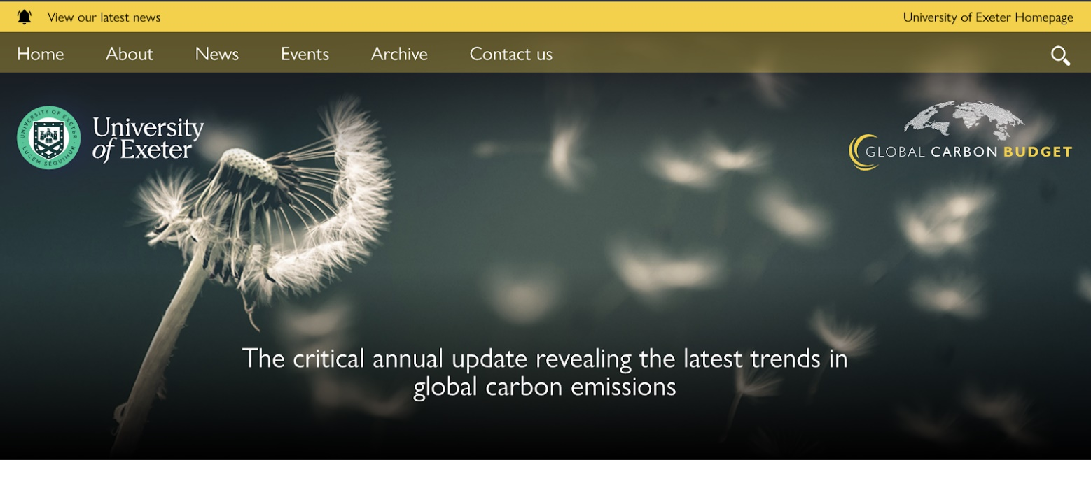
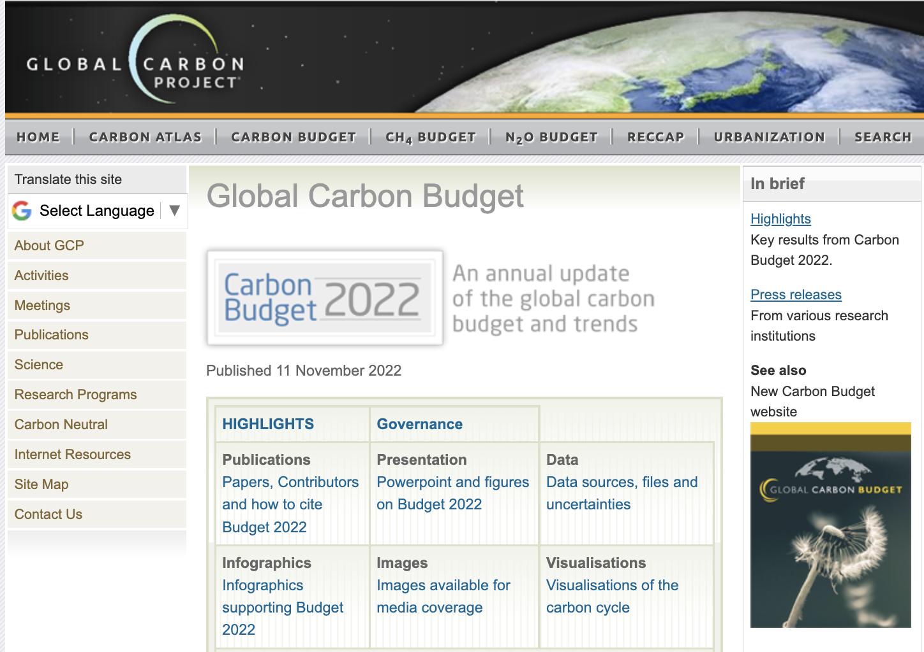
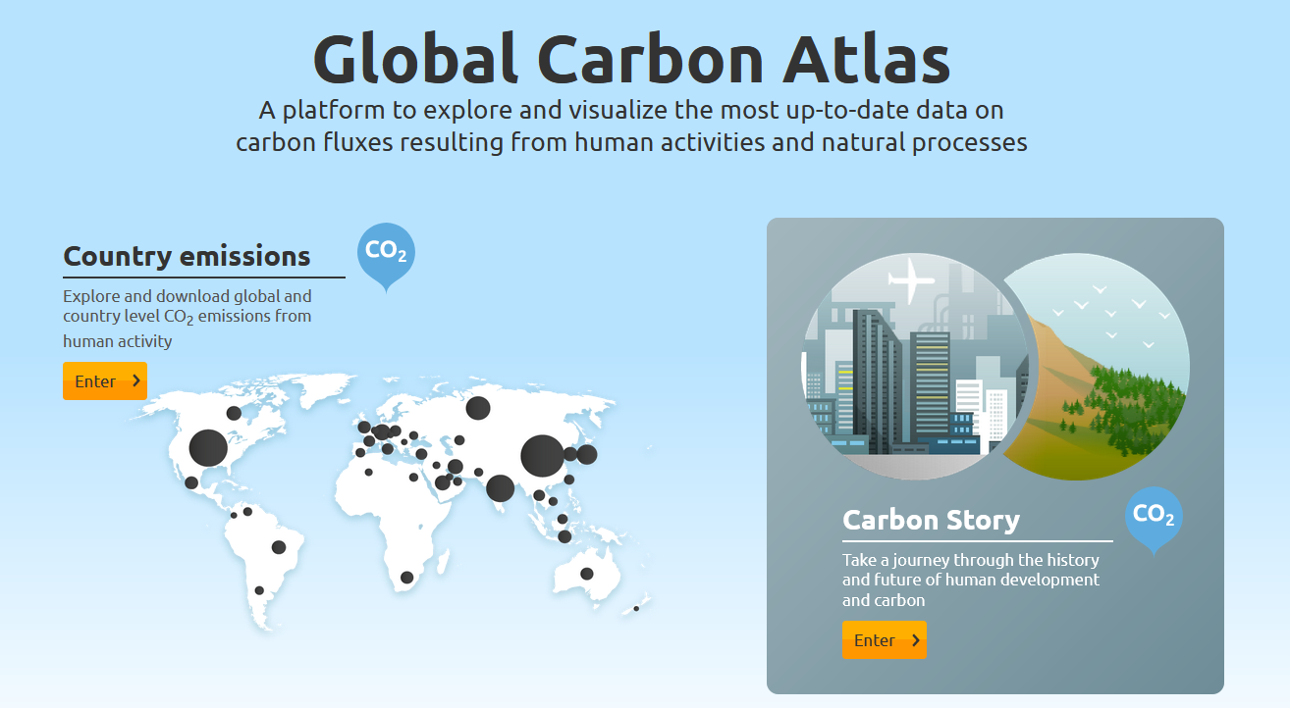
Data Access and Additional Resources
More information, data sources and data files:
https://globalcarbonbudget.org/carbonbudget
More information, data sources and data files:
http://www.globalcarbonproject.org/carbonbudget Contact: Pep.Canadell@csiro.au
More information, data sources and data files:
www.globalcarbonatlas.org
(co-funded in part by BNP Paribas Foundation)

Slide 5
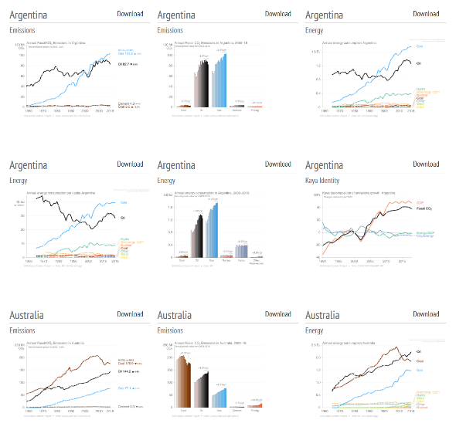
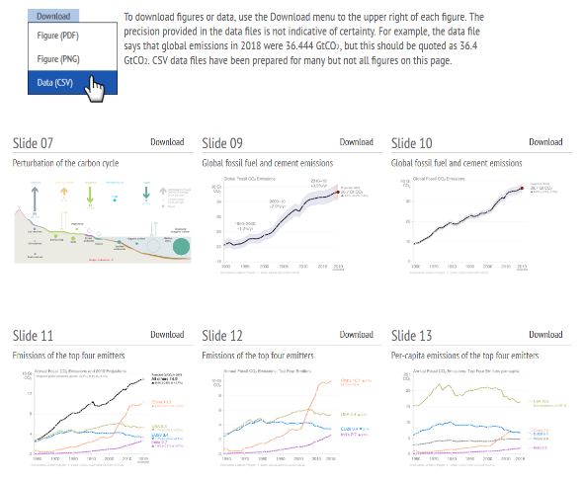
Download of figures and data
Global Carbon Budget
Additional country figures
Figures and data for most slides available from tinyurl.com/GCB22figs
and from https://globalcarbonbudget.org/carbonbudget

Slide 6
All the data is shown in billion tonnes CO₂ (GtCO₂)
1 Gigatonne (Gt) = 1 billion tonnes = 1×10¹⁵g = 1 Petagram (Pg)
1 kg carbon (C) = 3.664 kg carbon dioxide (CO₂)
1 GtC = 3.664 billion tonnes CO₂ = 3.664 GtCO₂
(Figures are available from https://globalcarbonbudget.org/carbonbudget)
Most figures in this presentation are available for download as PNG, PDF and SVG files
from tinyurl.com/GCB22figs along with the data required to produce them.
Disclaimer
The Global Carbon Budget and the information presented here are intended for those interested in learning about the carbon cycle, and how human activities are changing it. The information contained herein is provided as a public service, with the understanding that the Global Carbon Project team make no warranties, either expressed or implied, concerning the accuracy, completeness, reliability, or suitability of the information.

Slide 7

License
Our intention is that these figures and data are used. That’s why they’re released under the Creative Commons Attribution 4.0 International license. Simply put, you may freely copy and modify these figures and data, and use them in both commercial and non-commercial works, as long as you give credit to the Global Carbon Project.
If you’re just tweeting a figure or using a figure in a presentation, then it already says at the bottom that it’s by the Global Carbon Project, so you’re good to go! If you use the data directly or modify the figure then you will need to make sure the attribution is in place.
For details on the license, visit the Creative Commons website.
Suggested citation for use in a book: “Used with permission of the Global Carbon Project under the Creative Commons Attribution 4.0 International license.”

Slide 8
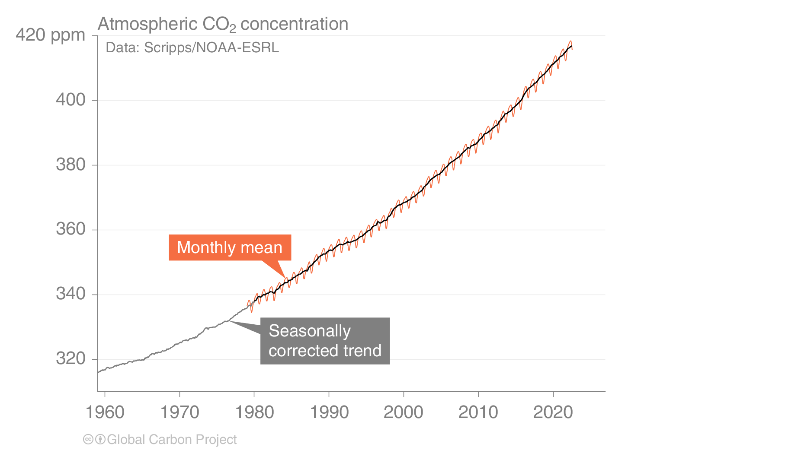
Atmospheric CO₂ concentration
The global CO₂ concentration increased from ~277 ppm in 1750 to 417.2 ppm in 2022 (up 51%)
Globally averaged surface atmospheric CO₂ concentration. Data from: NOAA-ESRL after 1980;
the Scripps Institution of Oceanography before 1980
Source: NOAA-ESRL; Scripps Institution of Oceanography; Friedlingstein et al 2022; Global Carbon Project 2022

Slide 9
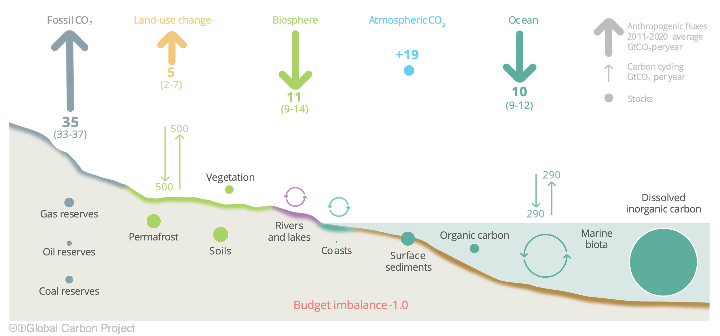
Anthropogenic perturbation of the global carbon cycle
Perturbation of the global carbon cycle caused by anthropogenic activities,
global annual average for the decade 2012–2021 (GtCO₂/yr)
The budget imbalance is the difference between the estimated emissions and sinks.
Source: NOAA-ESRL; Friedlingstein et al 2022; Canadell et al 2021 (IPCC AR6 WG1 Chapter 5); Global Carbon Project 2022

Slide 10
Key Highlights in 2022

Slide 11
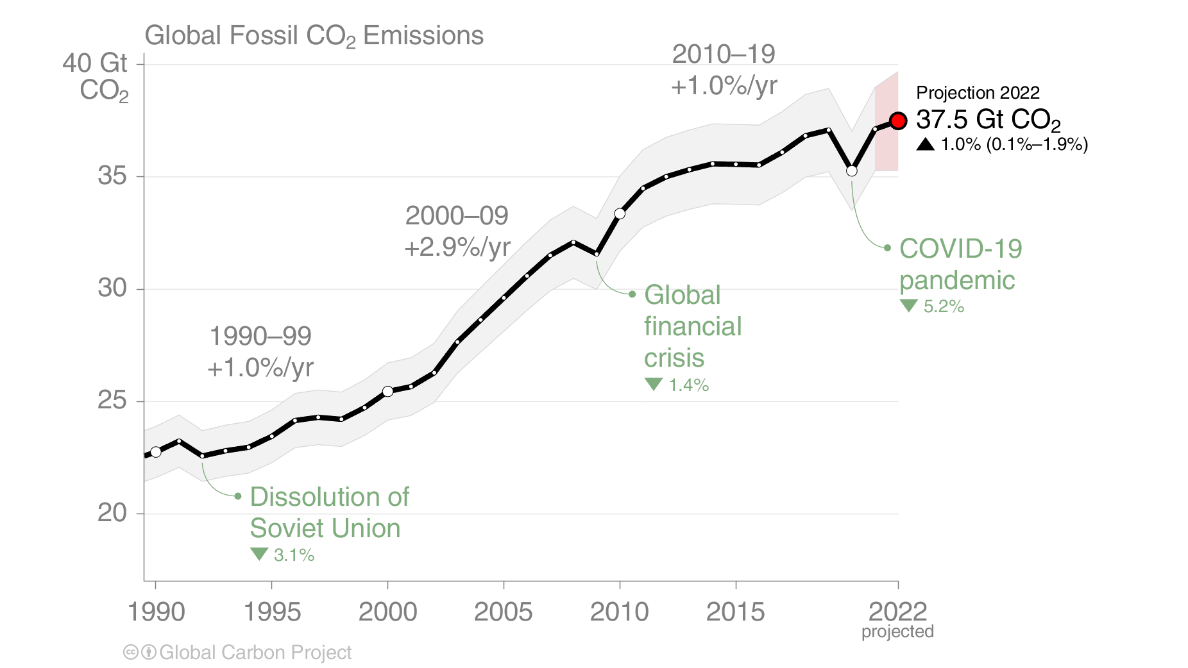
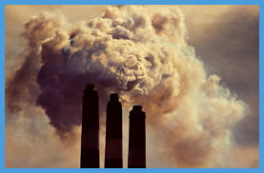
Global Fossil CO₂ Emissions
Global fossil CO₂ emissions: 37.1 ± 2 GtCO₂ in 2021, 63% over 1990
Projection for 2022: 37.5 ± 2 GtCO₂, 1.0% [0.1% to +1.9%] higher than 2021
Uncertainty is ±5% for one standard deviation (IPCC “likely” range)
When including cement carbonation, the 2021 and 2022 estimates amount to 36.3 ± 2 GtCO₂ and 36.6 ± 2 GtCO₂ respectively
The 2022 projection is based on preliminary data and modelling.
Source: Friedlingstein et al 2022; Global Carbon Project 2022

Slide 12
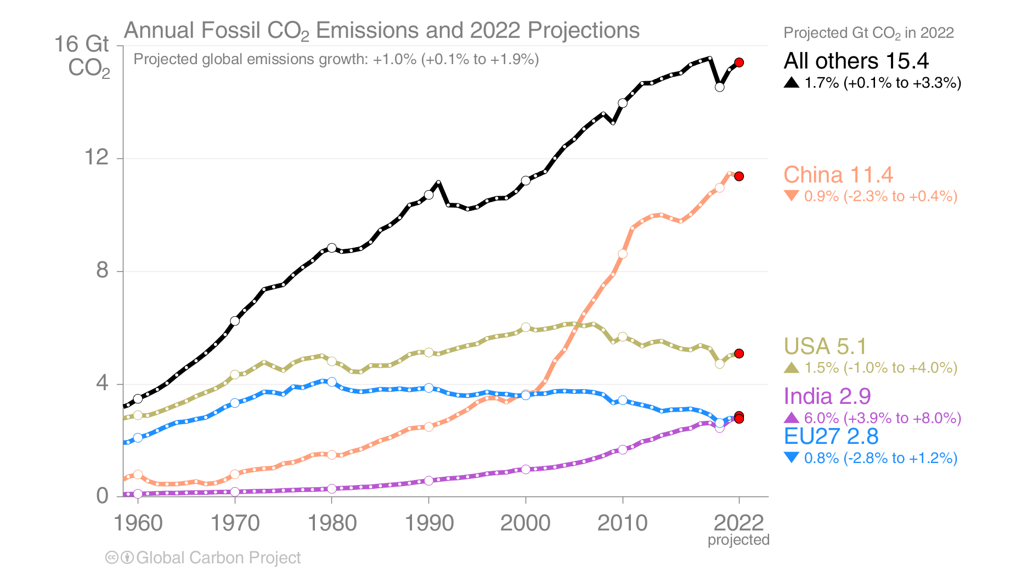
Emissions Projections for 2022
Global fossil CO₂ emissions are projected to increase by 1.0% [0.1% to 1.9%] in 2022
The 2022 projections are based on preliminary data and modelling.
Source: Friedlingstein et al 2022; Global Carbon Project 2022

Slide 13
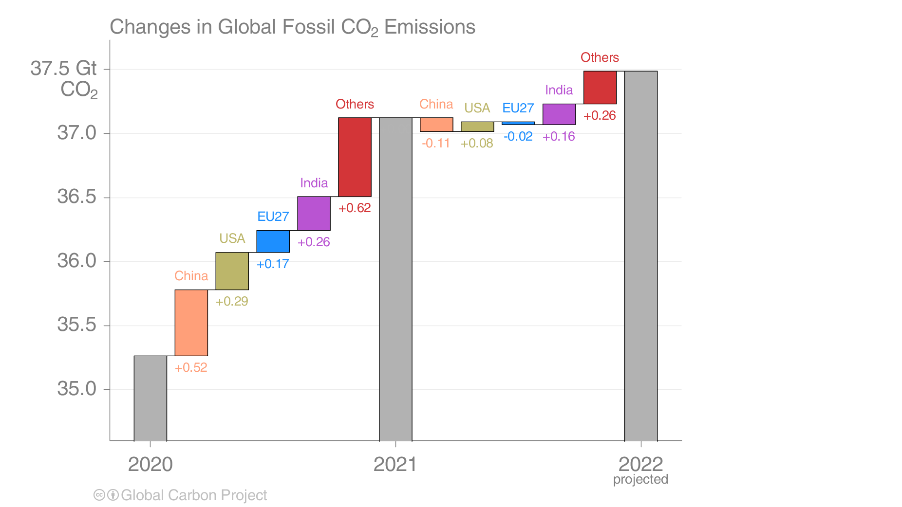
Fossil CO₂ emissions growth: 2020–2022
Emissions are expected to decrease in China and the EU in 2022,
and increase in USA, India and the combined rest of the world (Others)
Figure shows the top four countries contributing to emissions changes
International shipping and aviation are included in “Others”
Source: Friedlingstein et al 2022; Global Carbon Project 2022

Slide 14
Summary of fossil CO₂ emissions in 2021 and 2022
Region / Country | 2021 emissions (billion tonnes/yr) | 2021 growth (percent) | 2022 projected emissions growth (percent) | 2022 projected emissions (billion tonnes/yr)
China | 11.5 | +5.0% | -0.9% | 11.4
USA | 5.0 | +6.5% | +1.5% | 5.1
EU27 | 2.8 | +6.8% | -0.8% | 2.8
India | 2.7 | +11.1% | +6.0% | 2.9
All others (incl. IAS*) | 15.1 | +4.5% | +1.7% | 15.4
World (incl. IAS*) | 37.1 | +5.6% | +1.0% | 37.5
World (incl. IAS* and cement carbonation) | 36.3 | +5.6% | +1.0% | 36.6
*IAS: Emissions from use of international aviation and maritime shipping bunker fuels are not usually included in national totals
Cement carbonation sink only included in global (World) estimate
Source: Friedlingstein et al 2022; Global Carbon Project 2022

Slide 15
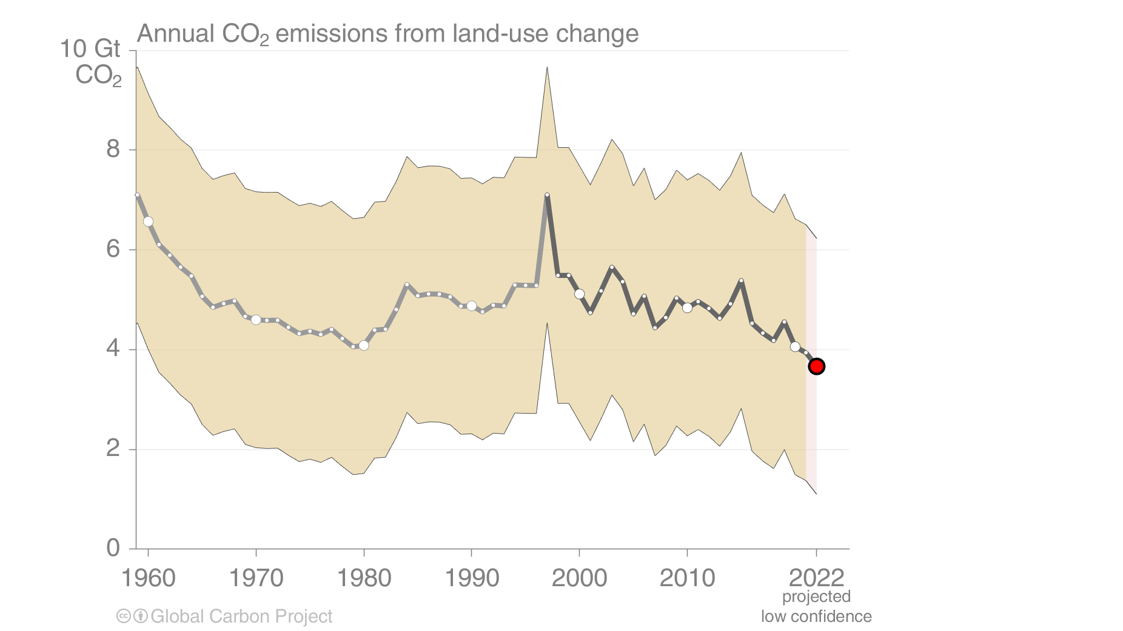
Land-use change emissions
Land-use change emissions are 4.5 ± 2.6 GtCO₂ per year for 2012-2021, and show a negative trend in the last two decades,
but estimates are still highly uncertain. Projection for 2022: 3.9 ± 2.6 GtCO₂
Indonesian fires
Estimates from three bookkeeping models
Source: Friedlingstein et al 2022; Global Carbon Project 2022

Slide 16
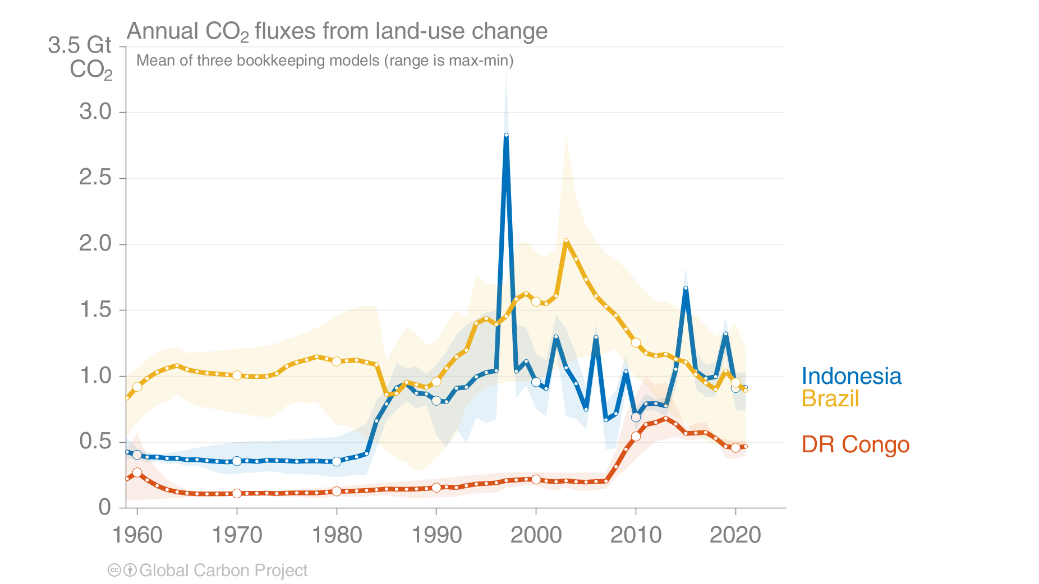
Land-use change emissions
Combined land-use change emissions from Brazil, the Democratic Republic of the Congo, and Indonesia
make up over 50% of the global net land-use change emissions
The peak in Indonesia in 1997 was the Indonesian peat fires
Estimates from three bookkeeping models
Source: Friedlingstein et al 2022; Global Carbon Project 2022

Slide 17
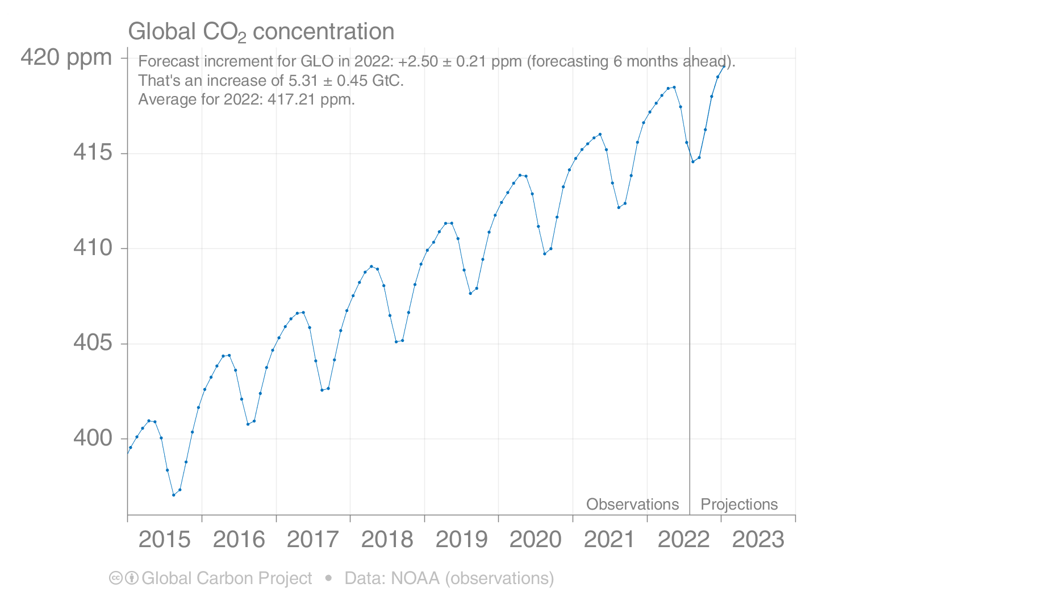
Forecast of global atmospheric CO₂ concentration
The global atmospheric CO₂ concentration is forecast to average 417 parts per million (ppm) in 2022, increasing by 2.5 ppm
Source: Friedlingstein et al 2022; Global Carbon Budget 2022

Slide 18
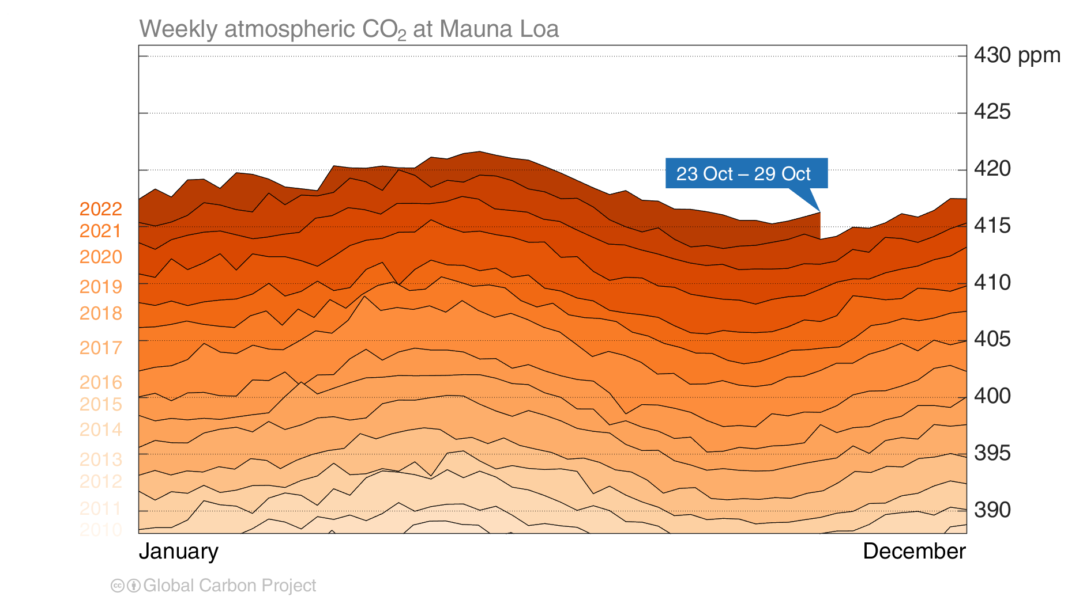
Mauna Loa atmospheric CO₂
Atmospheric CO₂ concentration has increased every single year,
including in 2020, despite the drop in fossil CO₂ emissions, because of continued emissions
Source: Tans and Keeling (2020); Friedlingstein et al 2022; Global Carbon Budget 2022

Slide 19
Global Fossil CO₂ Emissions

Slide 20
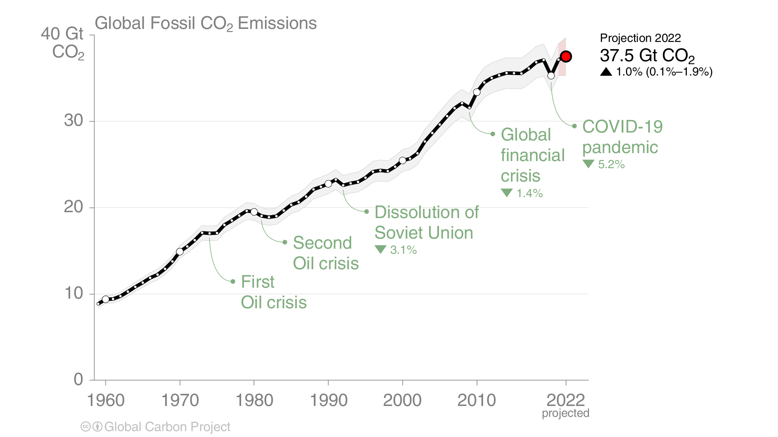
Global Fossil CO₂ Emissions
Global fossil CO₂ emissions have risen steadily over the last decades.
Emissions are set to grow again in 2022.
When including cement carbonation, the 2022 estimate is 36.6 ± 2 GtCO₂.
The 2022 projection is based on preliminary data and modelling.
Source: Friedlingstein et al 2022; Global Carbon Project 2022

Slide 21
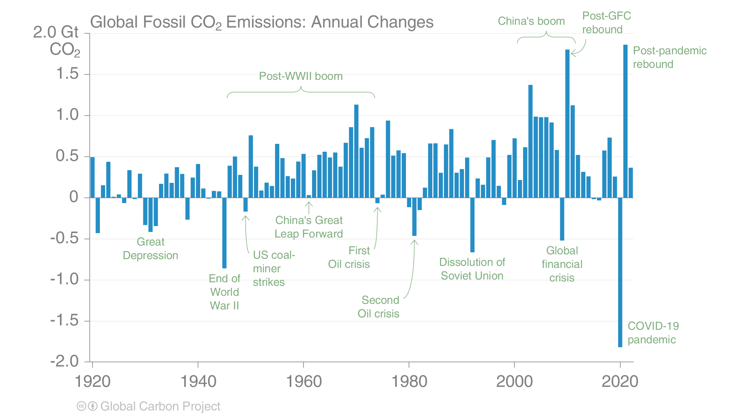
Global Fossil CO₂ Emissions
For the last 100 years, it has generally taken a crisis to drive global emissions reductions.
To stabilise temperatures, intentional, planned, sustained global reductions must begin.
The 2022 projection is based on preliminary data and modelling.
Source: Friedlingstein et al 2022; Global Carbon Project 2022

Slide 22
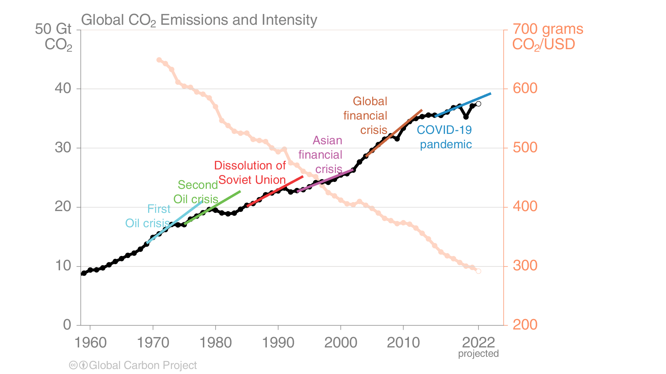
Fossil CO₂ emission intensity
Global CO₂ emissions growth has generally resumed quickly from global crises.
Emission intensity has steadily declined but not sufficiently to offset economic growth.
Each trend line is based on the five years before the crisis and extended to five years after.
Economic activity is measured in purchasing power parity (PPP) terms in 2010 US dollars.
Source: Friedlingstein et al 2022; Global Carbon Project 2022

Slide 23
Fossil CO₂ Emissions by country

Slide 24
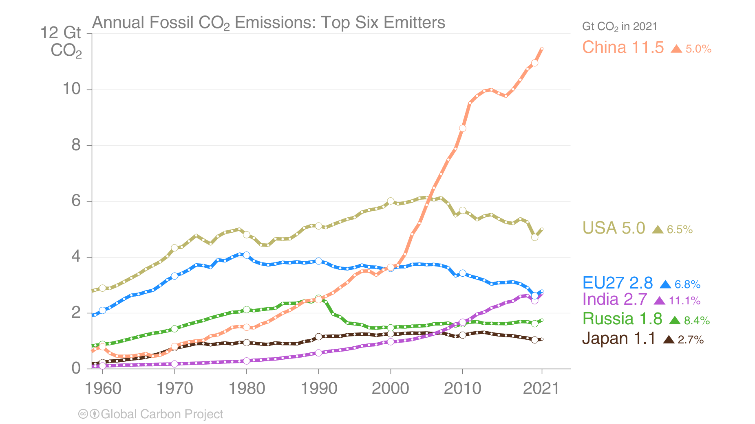
Top emitters: Fossil CO₂ Emissions to 2021
The top six emitters in 2021 covered 67% of global emissions
China 31%, United States 14%, EU27 8%, India 7%, Russia 5%, and Japan 3%
International aviation and maritime shipping (bunker fuels) contributed 2.8% of global emissions in 2021.
Source: Friedlingstein et al 2022; Global Carbon Project 2022

Slide 25
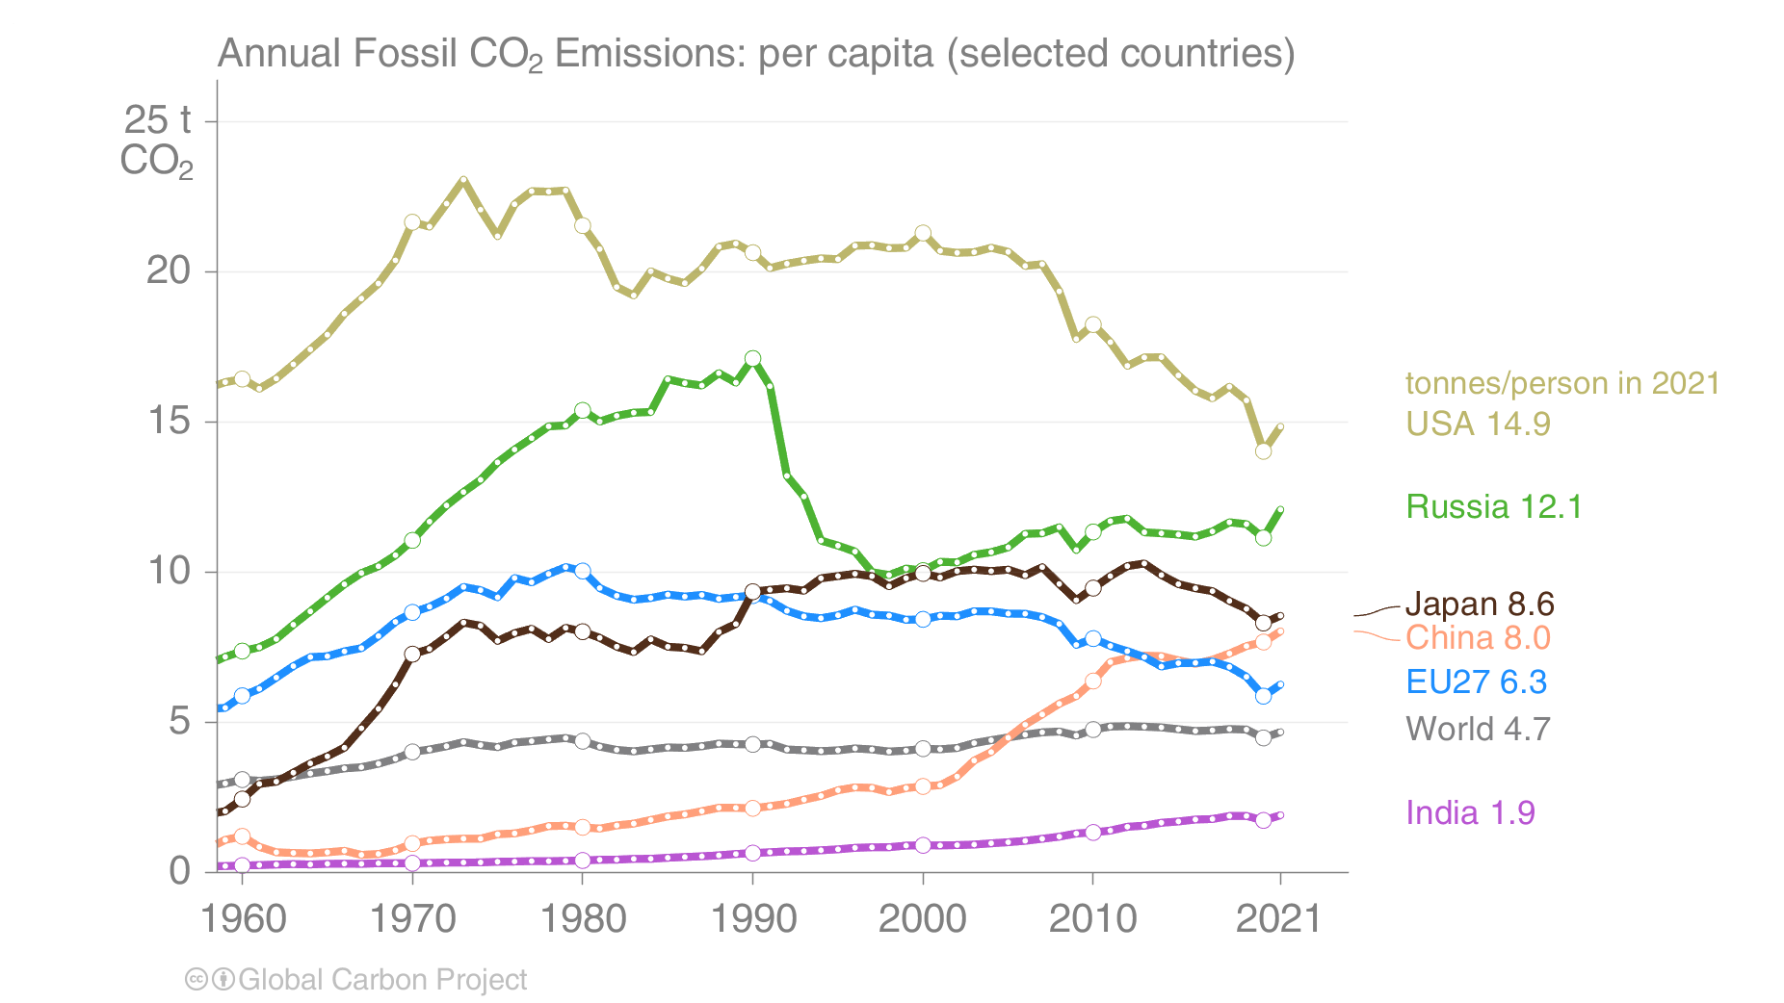
Top emitters: Fossil CO₂ Emissions per capita to 2021
Countries have a broad range of per capita emissions reflecting their national circumstances
Source: Friedlingstein et al 2022; Global Carbon Project 2022

Slide 26
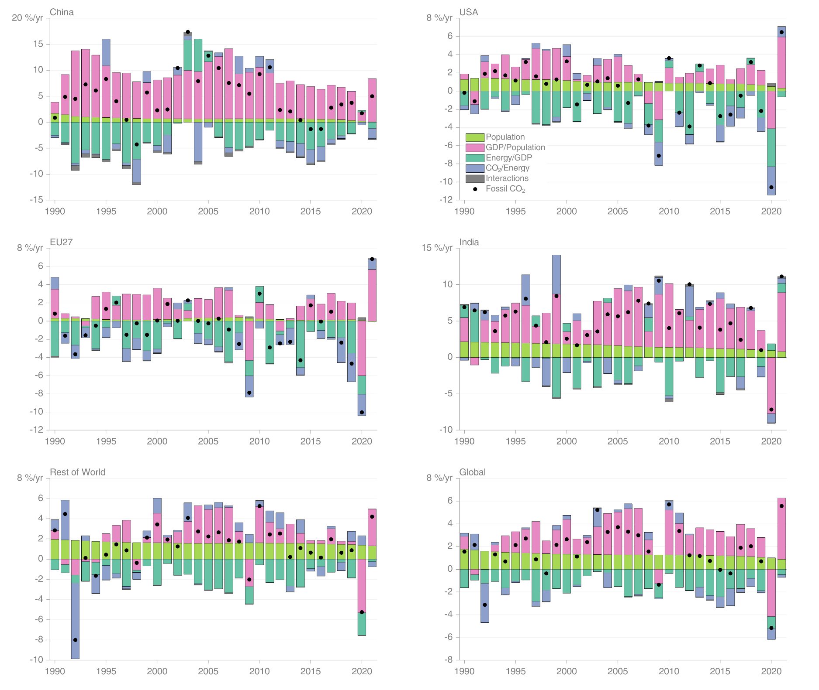
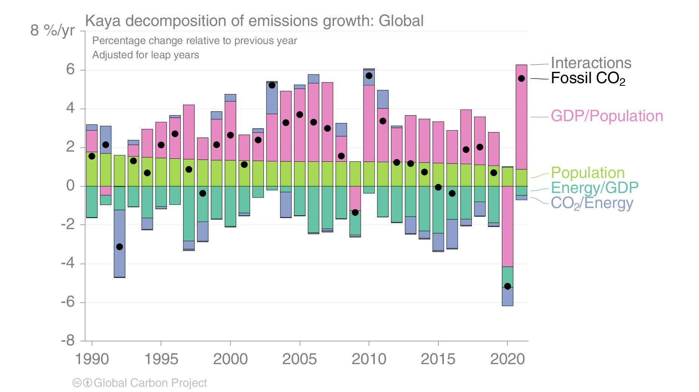
Fossil CO₂ emissions — Kaya decomposition
Globally, decarbonisation and declines in energy per GDP are largely responsible for the reduced growth rate in emissions over the last decade. 2020 was a clear outlier with a severe decline in GDP.
Source: Friedlingstein et al 2022; Global Carbon Project 2022

Slide 27
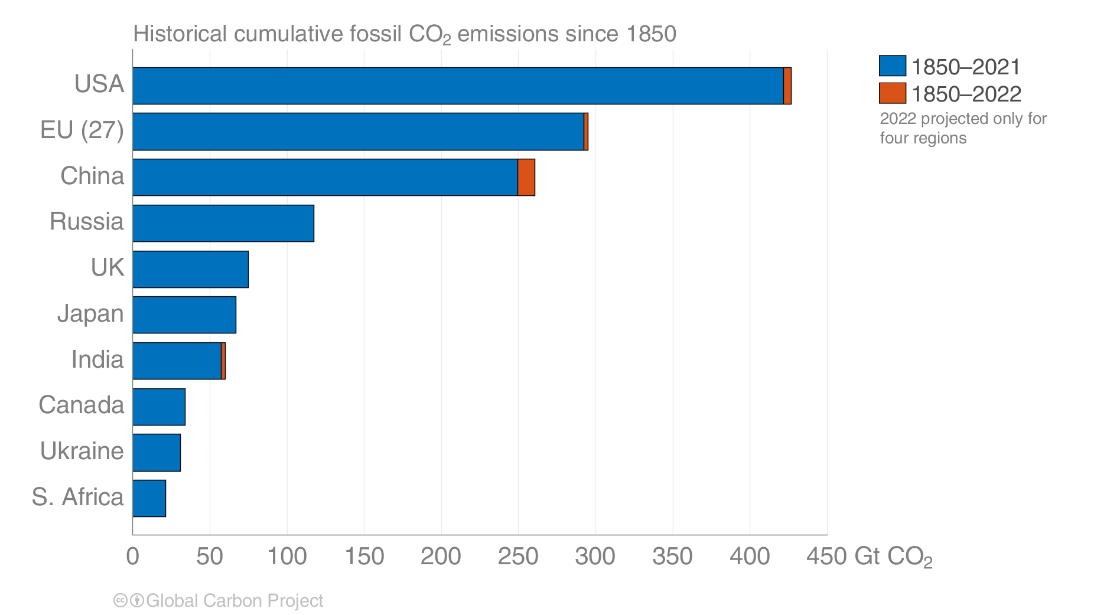
Historical cumulative fossil CO₂ emissions
The USA and EU have the highest accumulated fossil CO₂ emissions since 1850, but China is not far behind.
Calculated using territorial emissions.
Source: Friedlingstein et al 2022; Global Carbon Project 2022

Slide 28
Fossil CO₂ Emissions by source

Slide 29
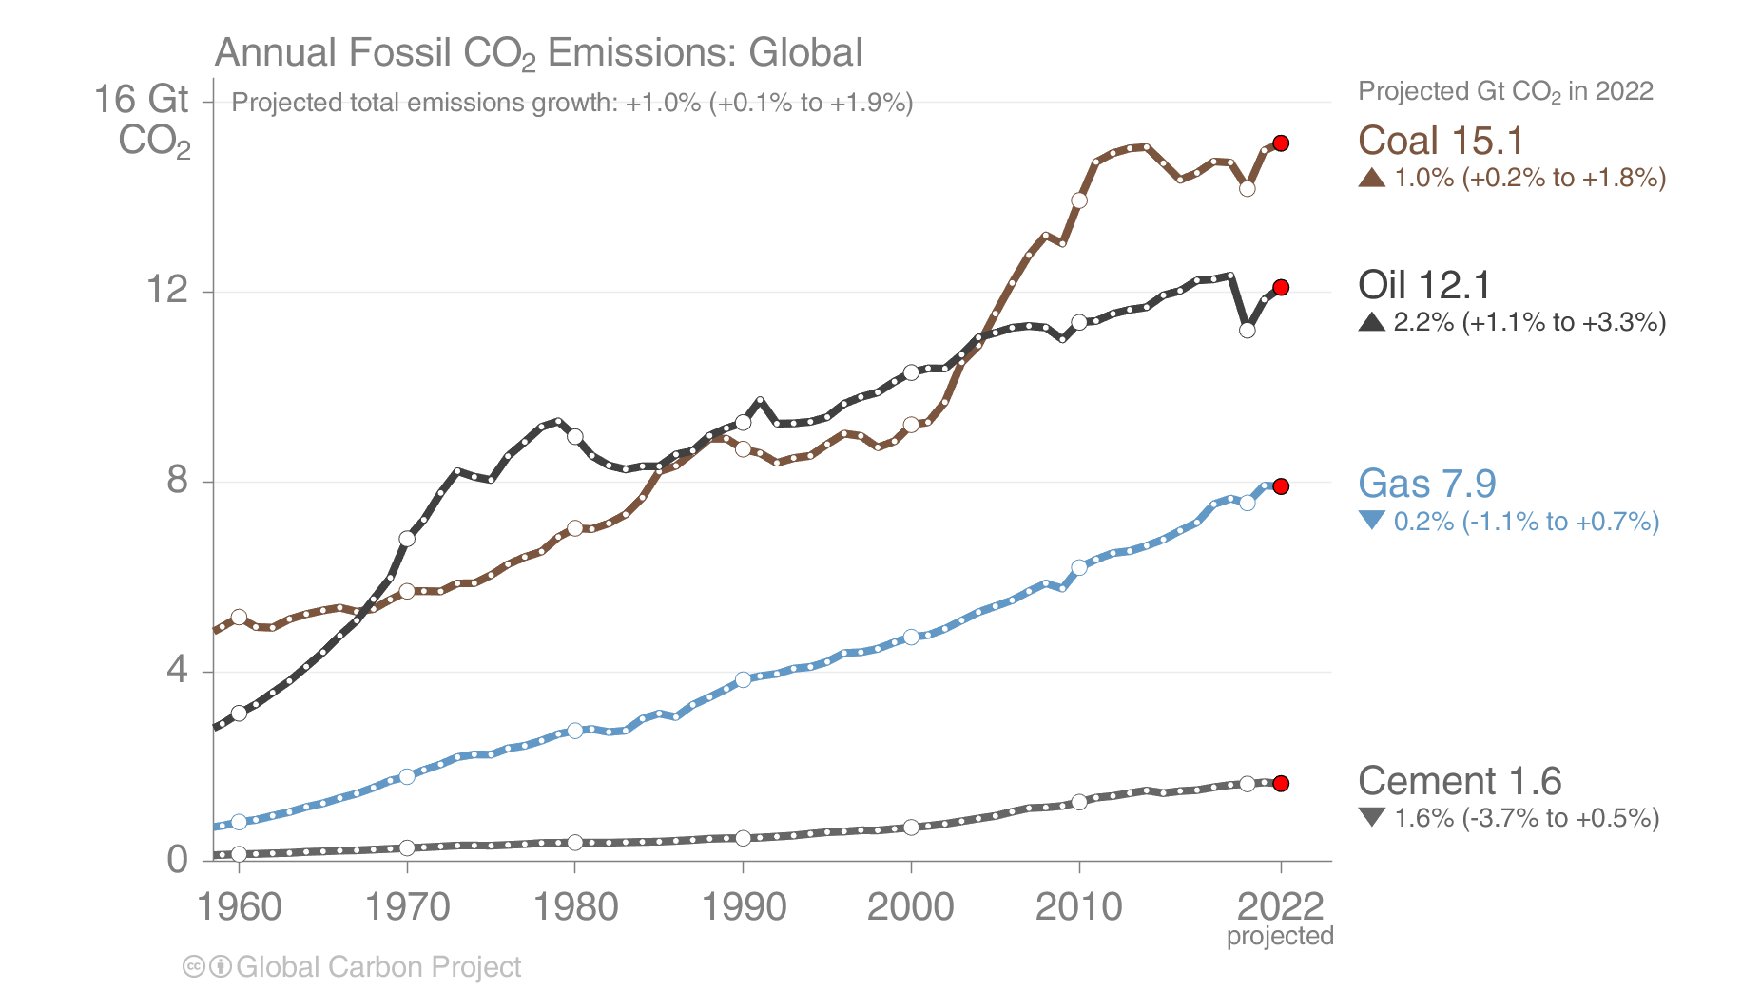
Fossil CO₂ Emissions by source
Share of global fossil CO2 emissions in 2021: coal (40%), oil (32%), gas (21%), cement (5%), flaring and others (2%, not shown)
Projection by fuel type is based on monthly data (GCP analysis)
Source: Friedlingstein et al 2022; Global Carbon Project 2022

Slide 30
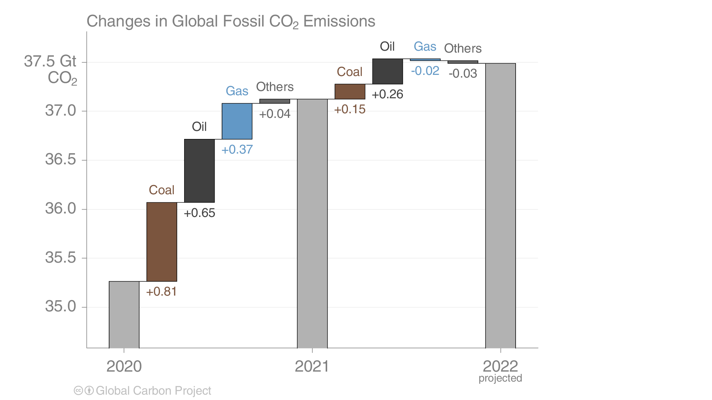
Fossil CO₂ emissions growth: 2020–2022
Global emissions in 2021 rebounded strongly from their 2020 drop across all categories.
In 2022 oil continues to recover, natural gas is down because of supply constraints, and coal is up.
Source: Friedlingstein et al 2022; Global Carbon Project 2022

Slide 31
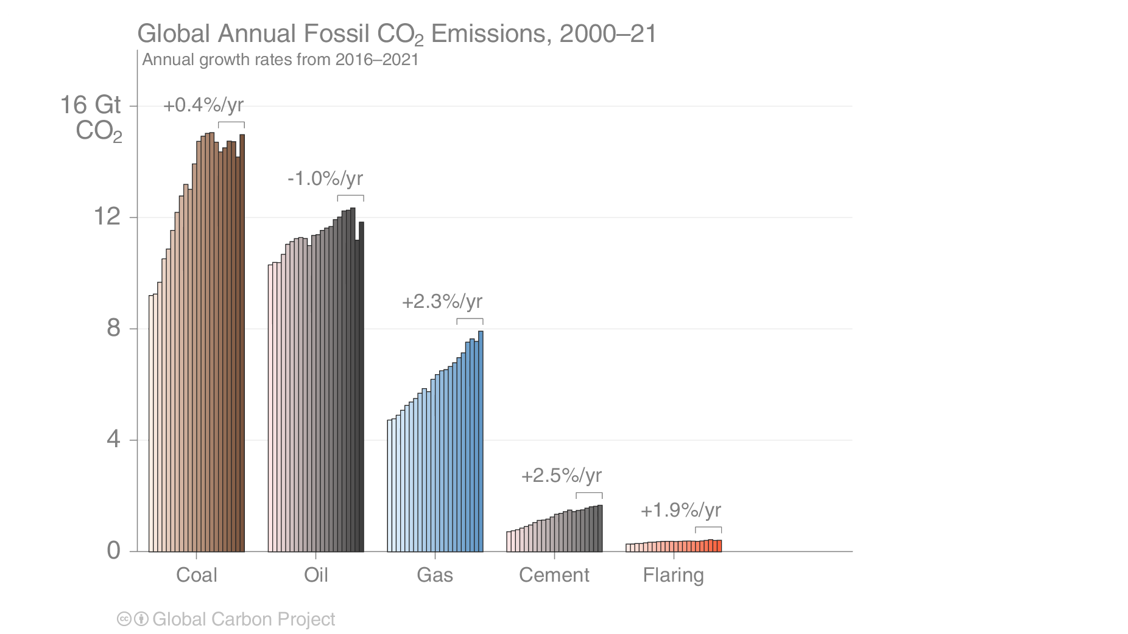
Fossil CO₂ Emissions by source
Emissions by category from 2000 to 2021, with growth rates indicated for the more recent period of 2016 to 2021
Coal use has declined since 2014, and both coal and oil declined sharply in the pandemic year 2020
Source: CDIAC; Global Carbon Project 2022

Slide 32
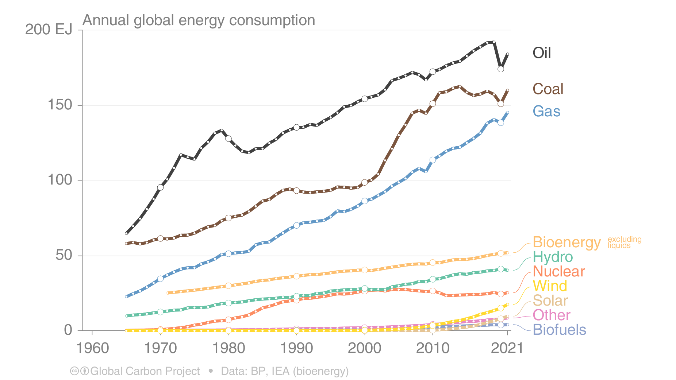
Energy use by source
Consumption of energy from fossil sources bounced back in 2021, but oil is still subdued.
Renewable energy continued to grow, but needs to grow even faster to replace fossil energy consumption.
This figure shows “primary energy” using the BP substitution method
(non-fossil sources are scaled up by an assumed fossil efficiency of approximately 0.38)
Source: BP 2022; Global Carbon Project 2022

Slide 33
Fossil CO₂ Emission by source for top emitters

Slide 34
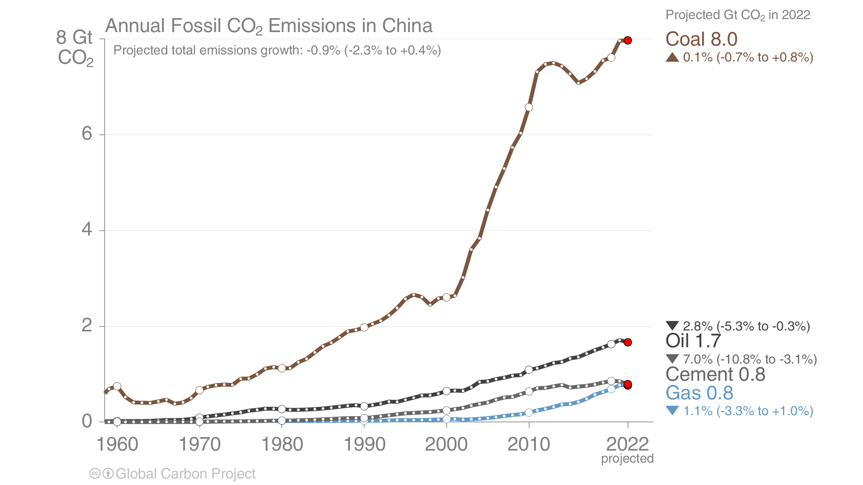
Fossil CO₂ Emissions in China
Annual emissions in China are expected to be about the same in 2022 as in 2021,
as COVID-19 lockdowns continue and the property market is slowing sharply
Source: Friedlingstein et al 2022; Global Carbon Project 2022

Slide 35
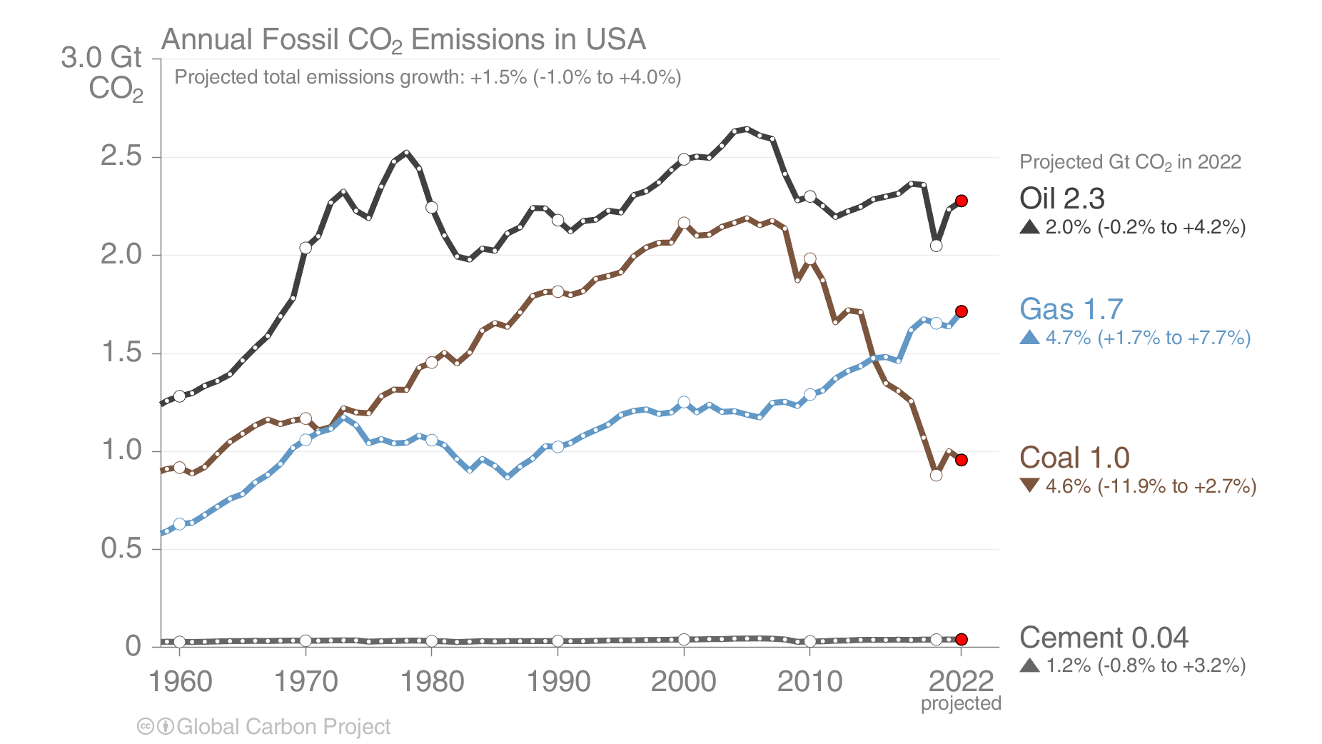
Fossil CO₂ Emissions in USA
The USA’s emissions from coal are expected to drop again in 2022, as the transition to natural gas continues.
Emissions from oil are still below 2019’s level.
Source: EIA 2022; Friedlingstein et al 2022; Global Carbon Project 2022

Slide 36
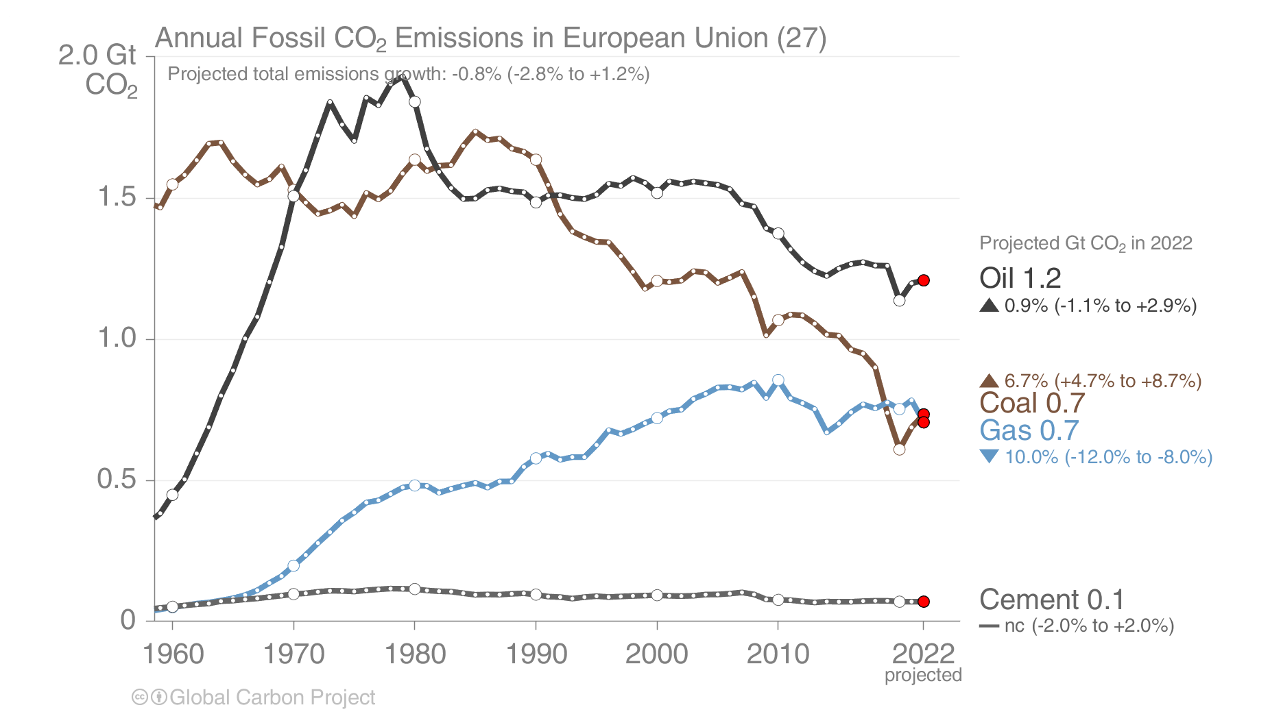
Fossil CO₂ Emissions in the European Union
The EU’s emissions from natural gas have dropped sharply in 2022 due to supply constraints. Use of coal has increased to fill the gap, but this is expected to be temporary. Oil continued to recover from the pandemic, albeit slowly.
Source: Friedlingstein et al 2022; Global Carbon Project 2022

Slide 37
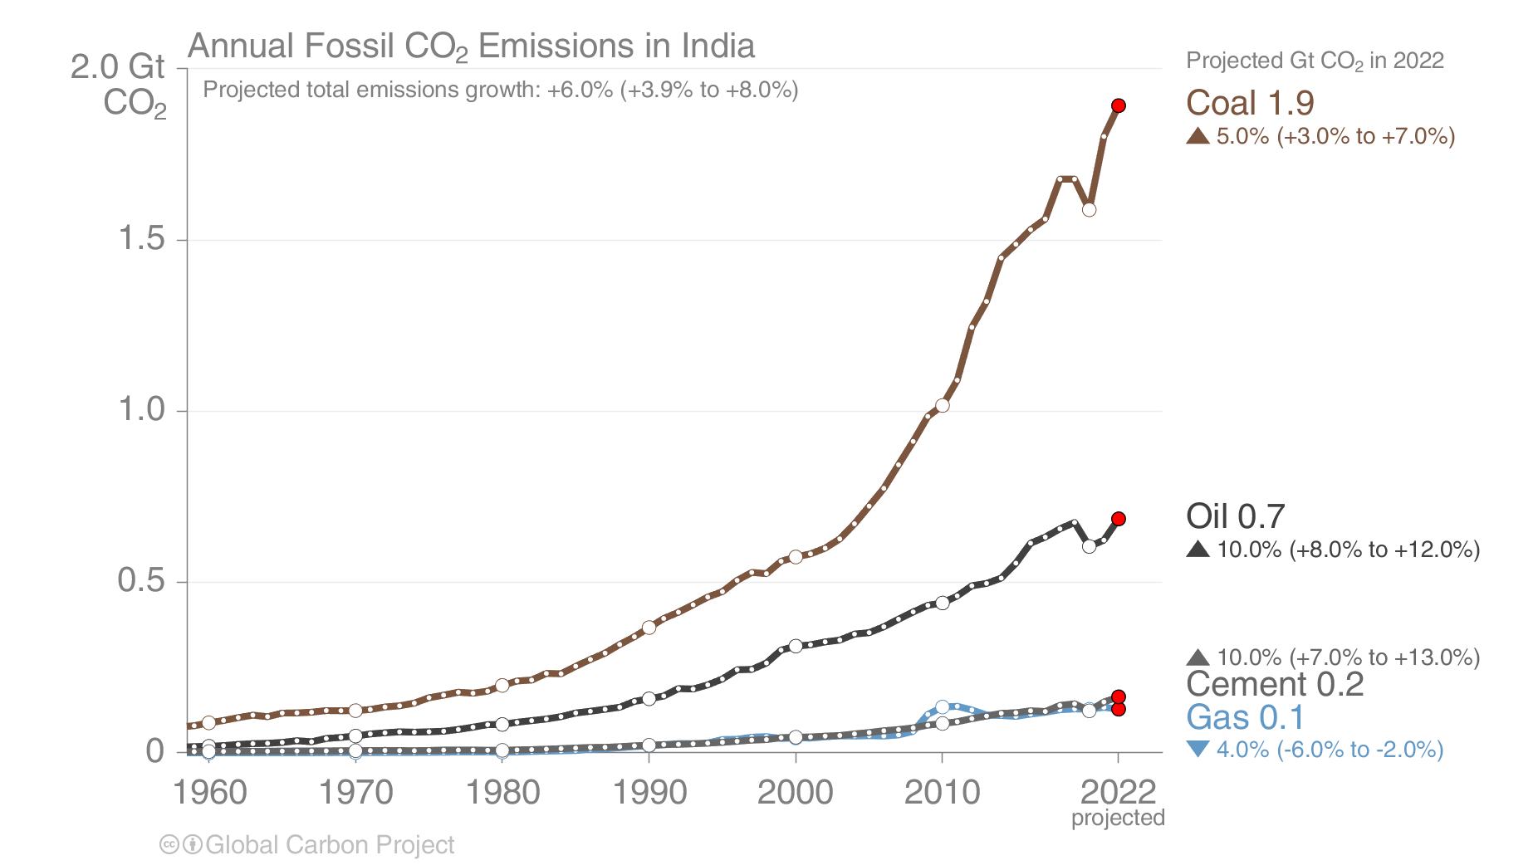
Fossil CO₂ Emissions in India
India’s emissions continue to grow sharply in 2022, with coal returning to its pre-pandemic trend.
Natural gas supplies are constrained, but these form a very small share of India’s energy supply.
Source: Friedlingstein et al 2022; Global Carbon Project 2022

Slide 38
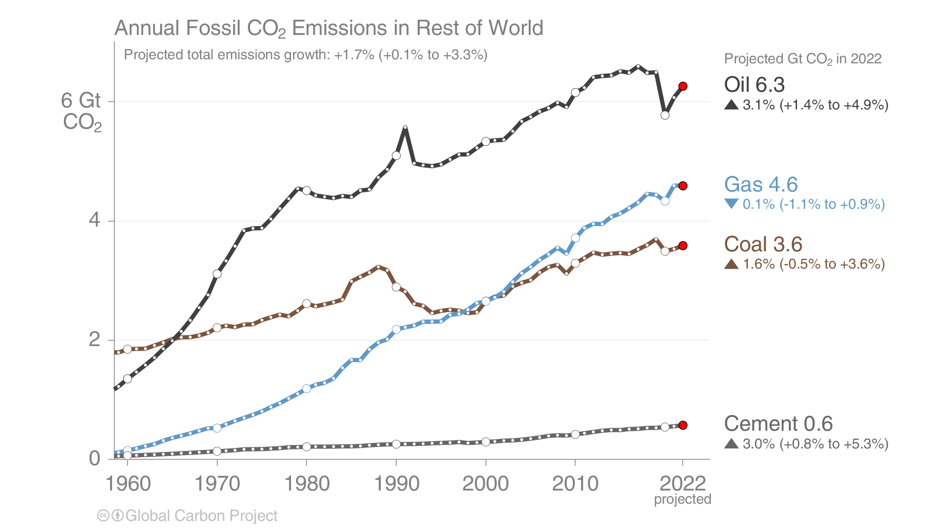
Fossil CO₂ Emissions in Rest of World
In the Rest of the World, emissions from coal grow slightly while natural gas declines on high prices.
Oil, which here includes internationship transport, remains below 2019 levels.
The Rest of the World is the global total less China, US, EU, and India. It also includes international aviation and maritime shipping.
Source: Friedlingstein et al 2022; Global Carbon Project 2022

Slide 39
Cement carbonation sink

Slide 40
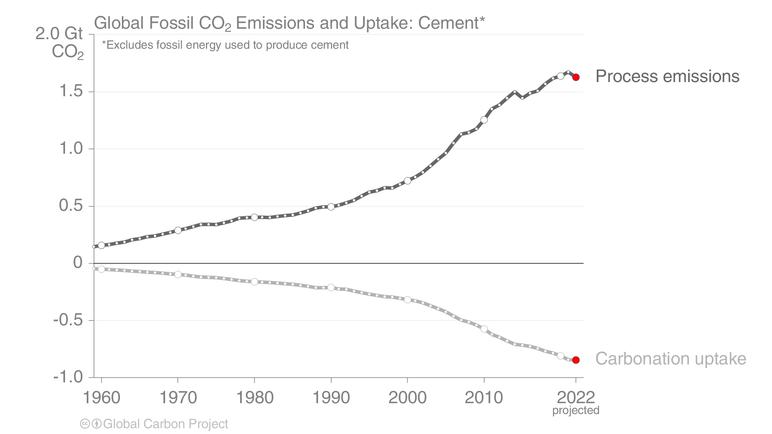
Cement carbonation sink
The production of cement results in ‘process’ emissions of CO₂ from the chemical reaction.
During its lifetime, cement slowly re-absorbs CO₂ from the atmosphere.
Source: Friedlingstein et al 2022; Global Carbon Project 2022

Slide 41
Land-use Change Emissions

Slide 42

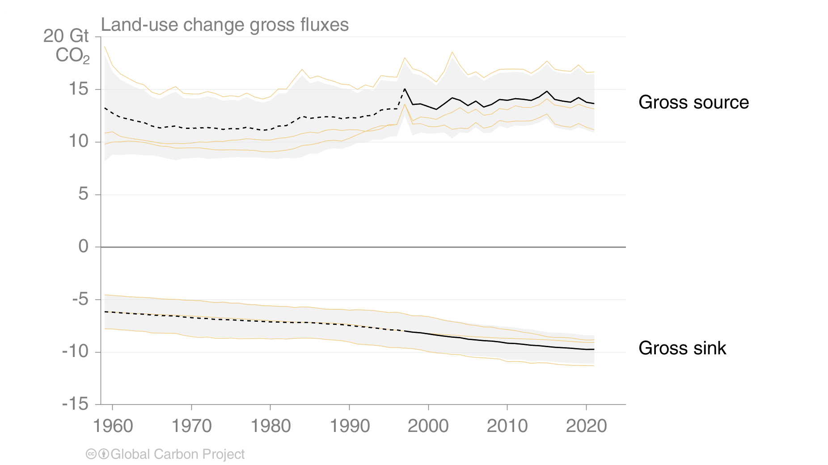
Land-use change emissions
Land-use change emissions are 4.5 ± 2.6 GtCO₂ per year for 2012-2021, and show a negative trend in the last two decades, but estimates are still highly uncertain.
Net land-use emissions are the difference between CO₂ emissions and CO₂ removals
Indonesian fires
Gross emissions
(2012-2021:
14.1 ± 2.6 GtCO₂/yr)
(14.1 ± 2.2 GtCO₂)
Deforestation, drainage & burning of organic soils, emissions from wood harvesting
Projection for 2022:
3.9 ± 2.6 GtCO₂.
Regrowth after agricultural abandonment, afforestation, regrowth after wood harvesting
Gross removals
(2012-2021:
9.5 ± 1.4 GtCO₂/yr)
(9.9 ± 1.4 GtCO₂)
Estimates from three bookkeeping models
Source: Friedlingstein et al 2022; Global Carbon Project 2022

Slide 43
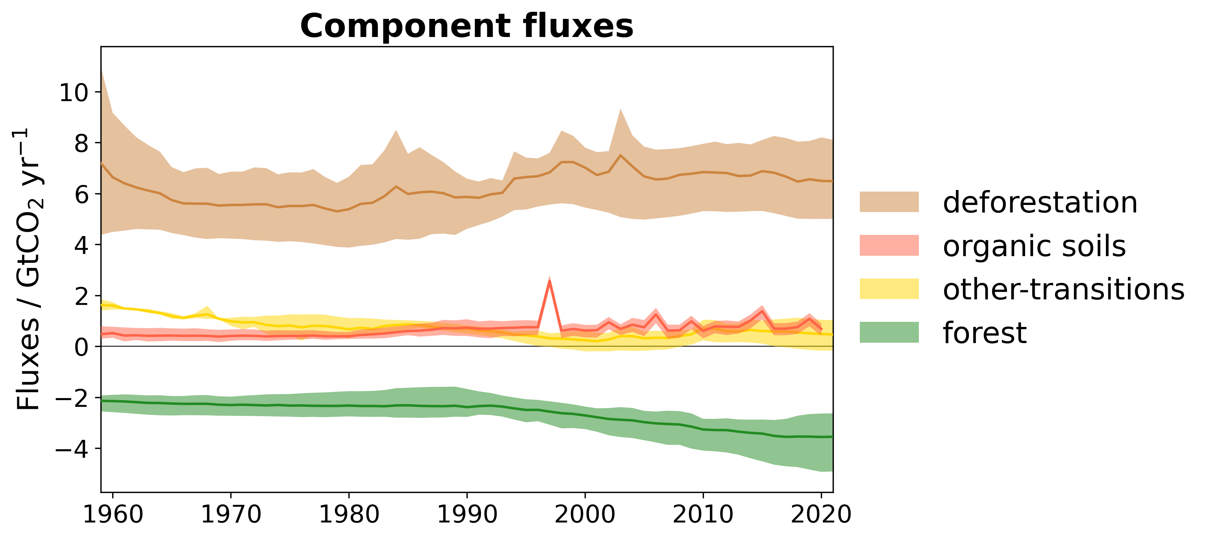
Drivers of land-use change emissions
Deforestation is the main driver of land-use emissions (remaining high at 6.7 ± 1.5 GtCO₂ per year for 2012-2021). Forest fluxes from re/afforestation and wood harvest emissions and removals counterbalance approximately half of these emissions (-3.5 ± 1.0 GtCO₂ per year).
Components of land-use change emissions
2012-2021 average Gt CO₂ per year
6.7 ± 1.5
0.8 ± 0.3
0.6 ± 0.5
-3.5 ± 1.0
Estimates from three bookkeeping models
Source: Friedlingstein et al 2022; Global Carbon Project 2022

Slide 44
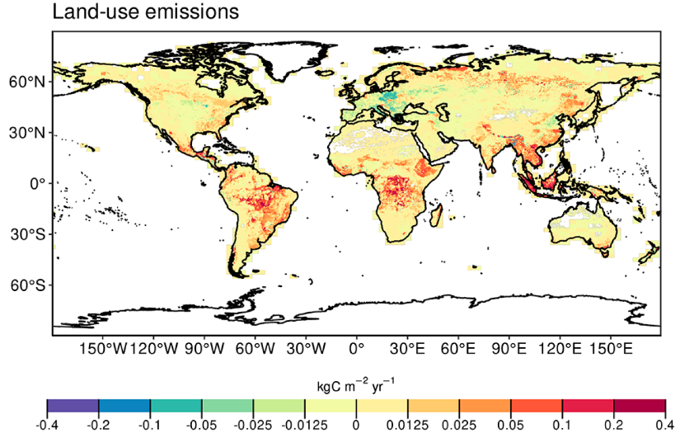
Regional patterns of land-use change emissions
The top three emitters over 2012-2021 – Indonesia, Brazil and the Democratic Republic of the Congo – contribute 58% of the global net land-use emissions.
Land-use emissions are high in the tropics, driven largely by deforestation. Net sinks occur in regions of re/afforestation such as parts of Europe and China.
Land-use emissions, decadal average 2012-2021
Source: Friedlingstein et al 2022; Global Carbon Project 2022
Estimates from the spatially explicit bookkeeping model BLUE (excluding emissions from organic soils)
The peak in Indonesia in 1997 was the Indonesian peat fires.
Estimates from three bookkeeping models

Slide 45
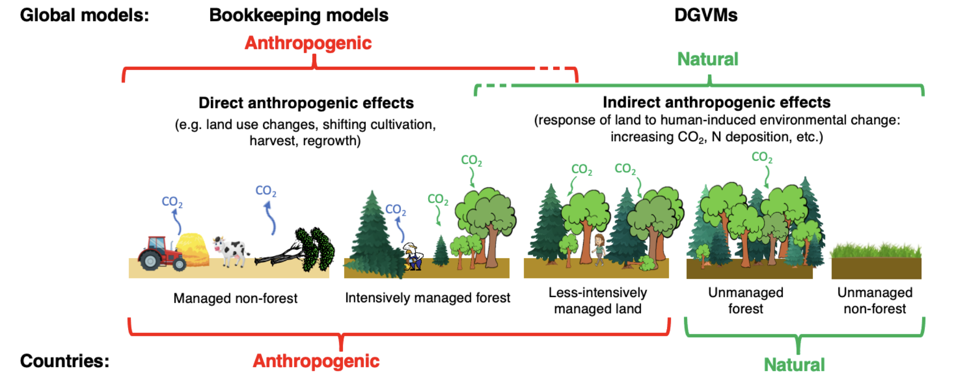
Linking global models to country reports
Mapping of global carbon cycle model land flux definitions to the definition of the LULUCF net flux used in national Greenhouse Gas Inventories (NGHGI) reported to UNFCCC
When natural fluxes on managed forests (-6.6 GtCO₂ per year for 2012-2021) are added to land-use emissions (4.5 GtCO₂ per year), the GCB2022 estimates (-2.1 GtCO₂ per year) are very similar to the country-reported data (-2.0 GtCO₂ per year), linking the anthropogenic carbon budget estimates of land CO₂ fluxes directly to the Global Stocktake as part of UNFCCC Paris Agreement.
Source: Friedlingstein et al 2022; Global Carbon Project 2022
Figure from Grassi et al., ESSDD 2022

Slide 46
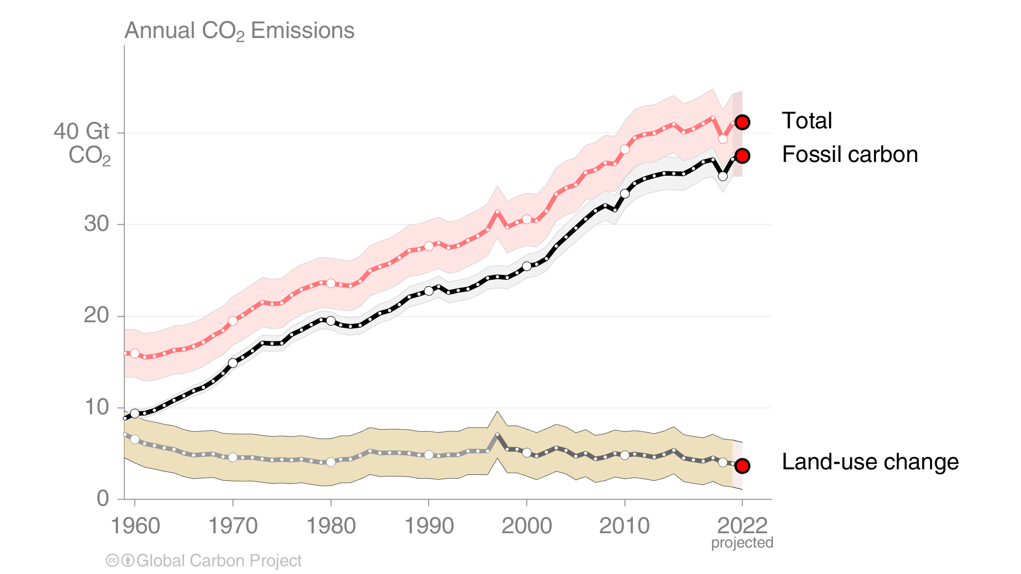

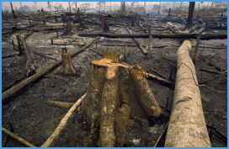
Total global emissions
Total global emissions: 41.1 ± 3.3 GtCO₂ in 2021, 49% over 1990
Percentage land-use change: 41% in 1960, 11% averaged 2012–2021
Land-use change estimates from three bookkeeping models, using fire-based variability from 1997
Source: Friedlingstein et al 2022; Global Carbon Project 2022

Slide 47
Closing the Global Carbon Budget

Slide 48

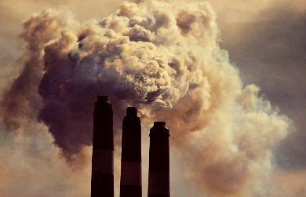

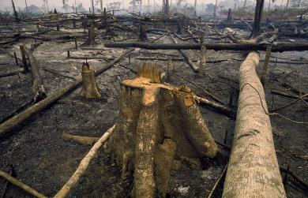

Fate of anthropogenic CO₂ emissions (2012–2021)
Sources = Sinks
19.1 GtCO₂/yr
48%
35.2 GtCO₂/yr
89%
29%
11.4 GtCO₂/yr
11%
4.5 GtCO₂/yr
26%
10.5 GtCO₂/yr
Budget Imbalance:
(the difference between estimated sources & sinks)
3%
-1.2 GtCO₂/yr
Source: Friedlingstein et al 2022; Global Carbon Project 2022

Slide 49
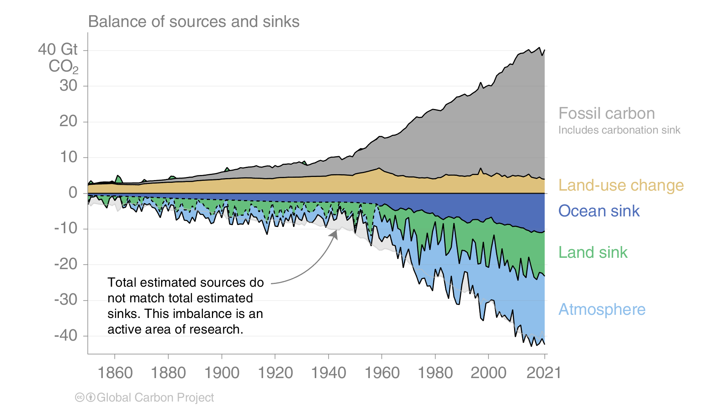
Global carbon budget
Carbon emissions are partitioned among the atmosphere and carbon sinks on land and in the ocean
The “imbalance” between total emissions and total sinks is an active area of research
Source: Friedlingstein et al 2022; Global Carbon Project 2022

Slide 50
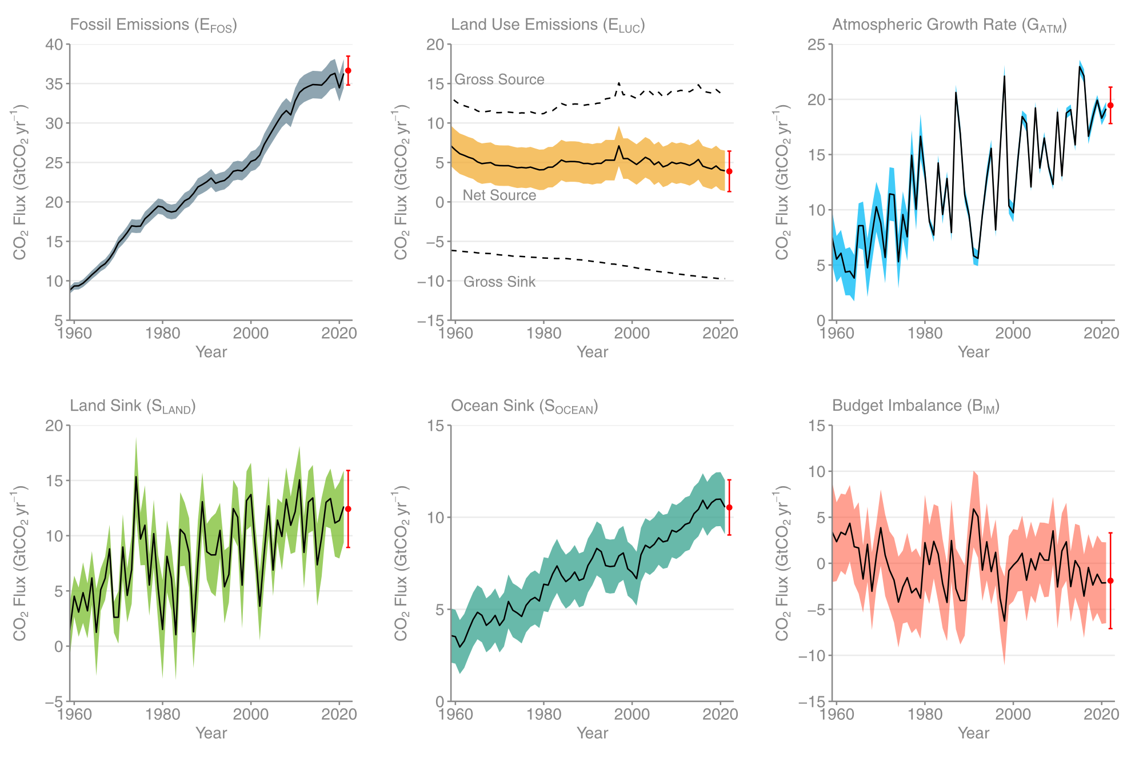
Changes in the budget over time
The sinks have continued to grow with increasing emissions, but climate change will affect
carbon cycle processes in a way that will exacerbate the increase of CO₂ in the atmosphere
The budget imbalance is the total emissions minus the estimated growth in the atmosphere, land and ocean.
It reflects the limits of our understanding of the carbon cycle.
Source: Friedlingstein et al 2022; Global Carbon Project 2022

Slide 51
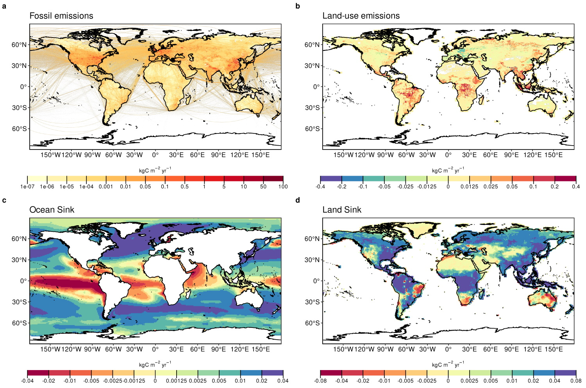
Global carbon budget
Fossil emissions dominate in the Northern Hemisphere, while land-use emissions are important in the tropics.
The North Atlantic and Southern Ocean are carbon sinks while the tropical ocean is a source of CO₂.
Tropical, temperate and boreal forest are the main terrestrial carbon sinks
CO₂ Source
CO₂ Sink
CO₂ Source
Source: Friedlingstein et al 2022; Global Carbon Budget 2022
CO₂ Source
CO₂ Sink
CO₂ Source
CO₂ Sink

Slide 52
Atmospheric concentration
The atmospheric concentration growth rate has increased steadily.
The high growth in 1987, 1998, & 2015–16 reflect a strong El Niño, which weakens the land sink.
Projected 2022
Source: NOAA-ESRL; Friedlingstein et al 2022; Global Carbon Project 2022

Slide 53
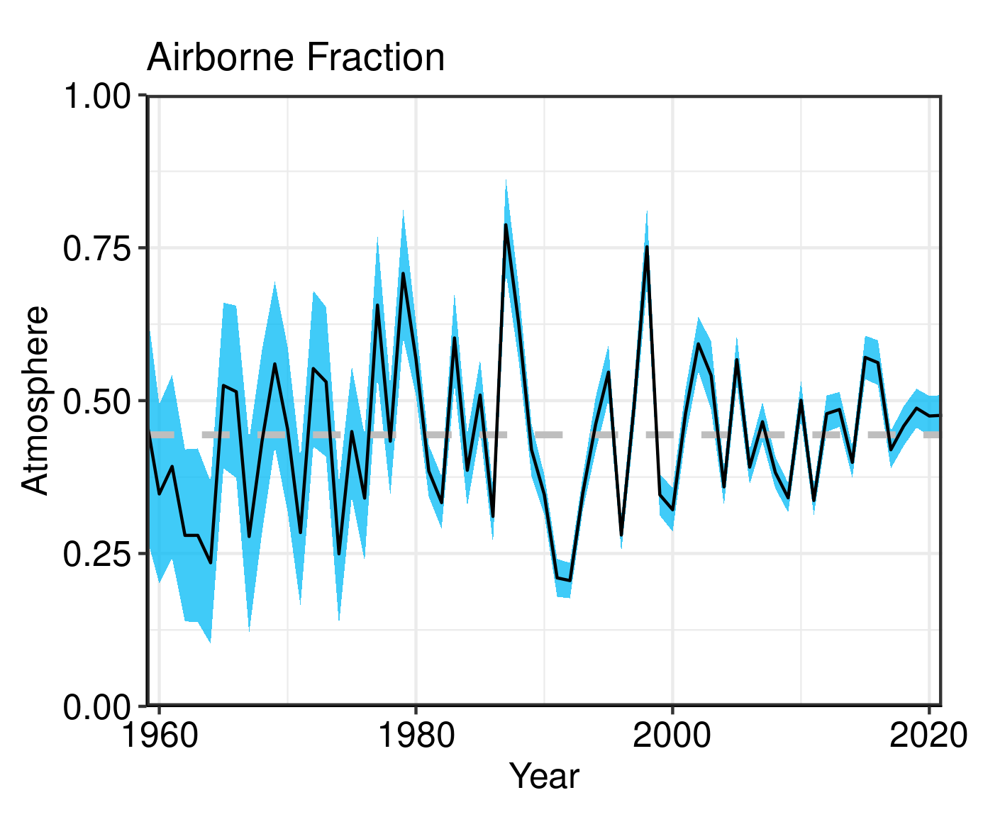
Airborne Fraction
The airborne fraction is the proportion of the total annual CO₂ emissions that remains in the atmosphere.
The rest of the CO₂ emissions are removed by the land and ocean sinks.
Around 45% of CO₂ emissions remain in the atmosphere despite sustained growth in CO₂ emissions.
Source: NOAA-ESRL; Global Carbon Project 2022

Slide 54
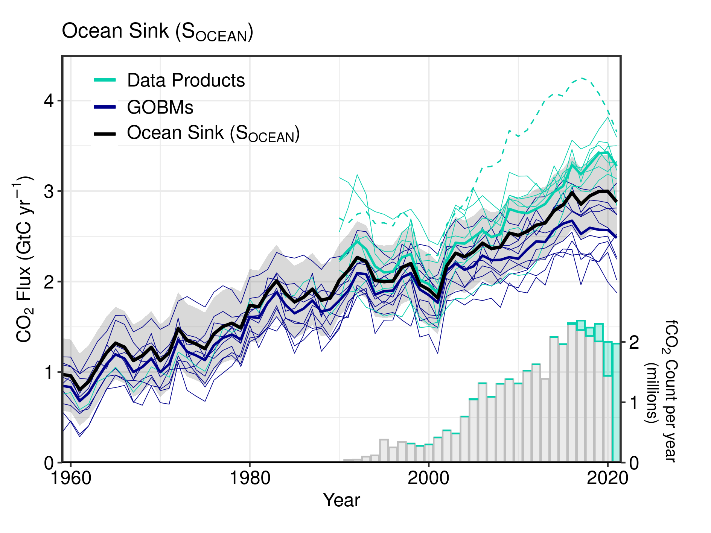
Ocean sink
The ocean carbon sink, estimated by Global Ocean Biogeochemical Models and observation-based data products,
continues to increase 10.5 ± 1.5 GtCO₂/yr for 2012–2021 and 10.6 ± 1.5 GtCO₂/yr in 2021
Note
Data are in GtC as in the ESSD publication.
Multiply by 3.664 to convert to GtCO₂
Source: SOCATv7; Bakker et al 2016; Friedlingstein et al 2022; Global Carbon Project 2022

Slide 55
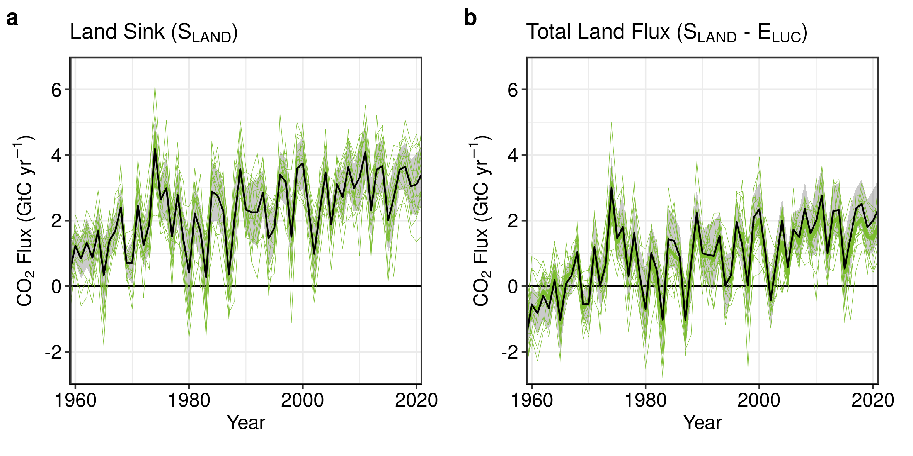
Terrestrial sink
The land carbon sink, estimated by Dynamic Global Vegetation Models, was 11.4 ± 2.3 GtCO₂/yr
during 2012–2021 and 12.6 ± 3.3 GtCO₂/yr in 2021.
The total CO₂ fluxes on land (including land-use change) are also constrained by atmospheric inversions.
Note
Data are in GtC as in the ESSD publication.
Multiply by 3.664 to convert to GtCO₂
Source: Friedlingstein et al 2022; Global Carbon Project 2022

Slide 56
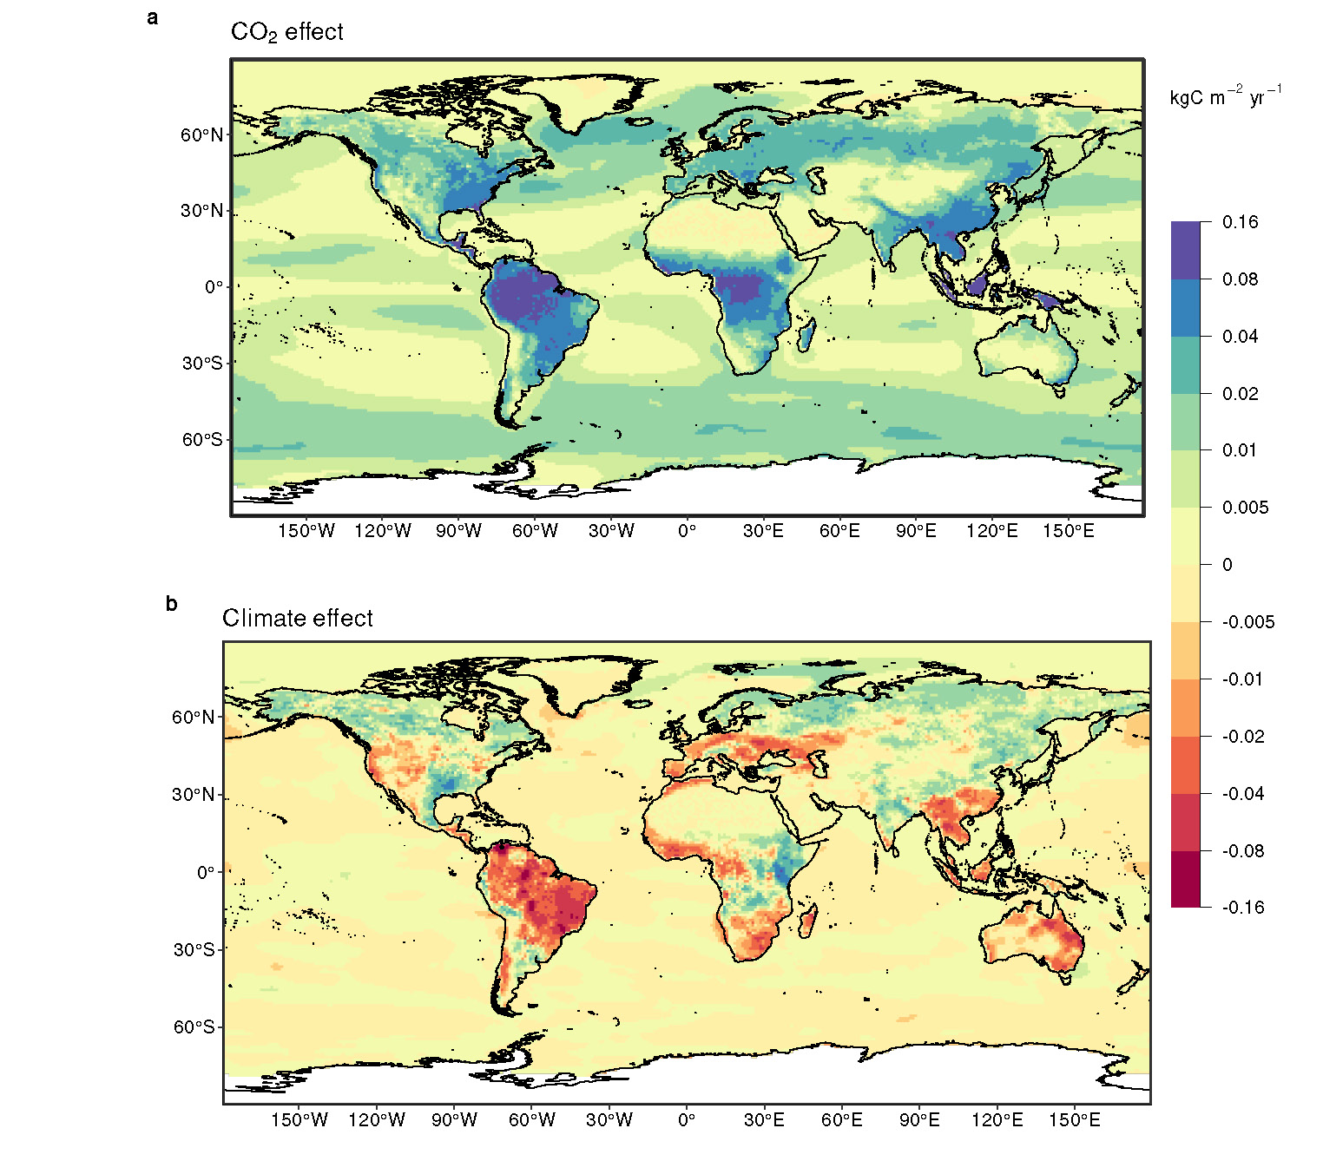
Land and ocean sinks — Effects of CO₂ vs climate change
Process models suggest that increasing atmospheric CO₂ drives the land and ocean sinks while climate change reduces the carbon sinks; the climate effect is largest in tropical and semi-arid land ecosystems.
Globally during the 2012-2021 decade, climate change reduced the land sink by ~17% and the ocean sink by ~4%
CO₂ Sink
CO₂ Source
Source: Friedlingstein et al 2022; Global Carbon Budget 2022

Slide 57
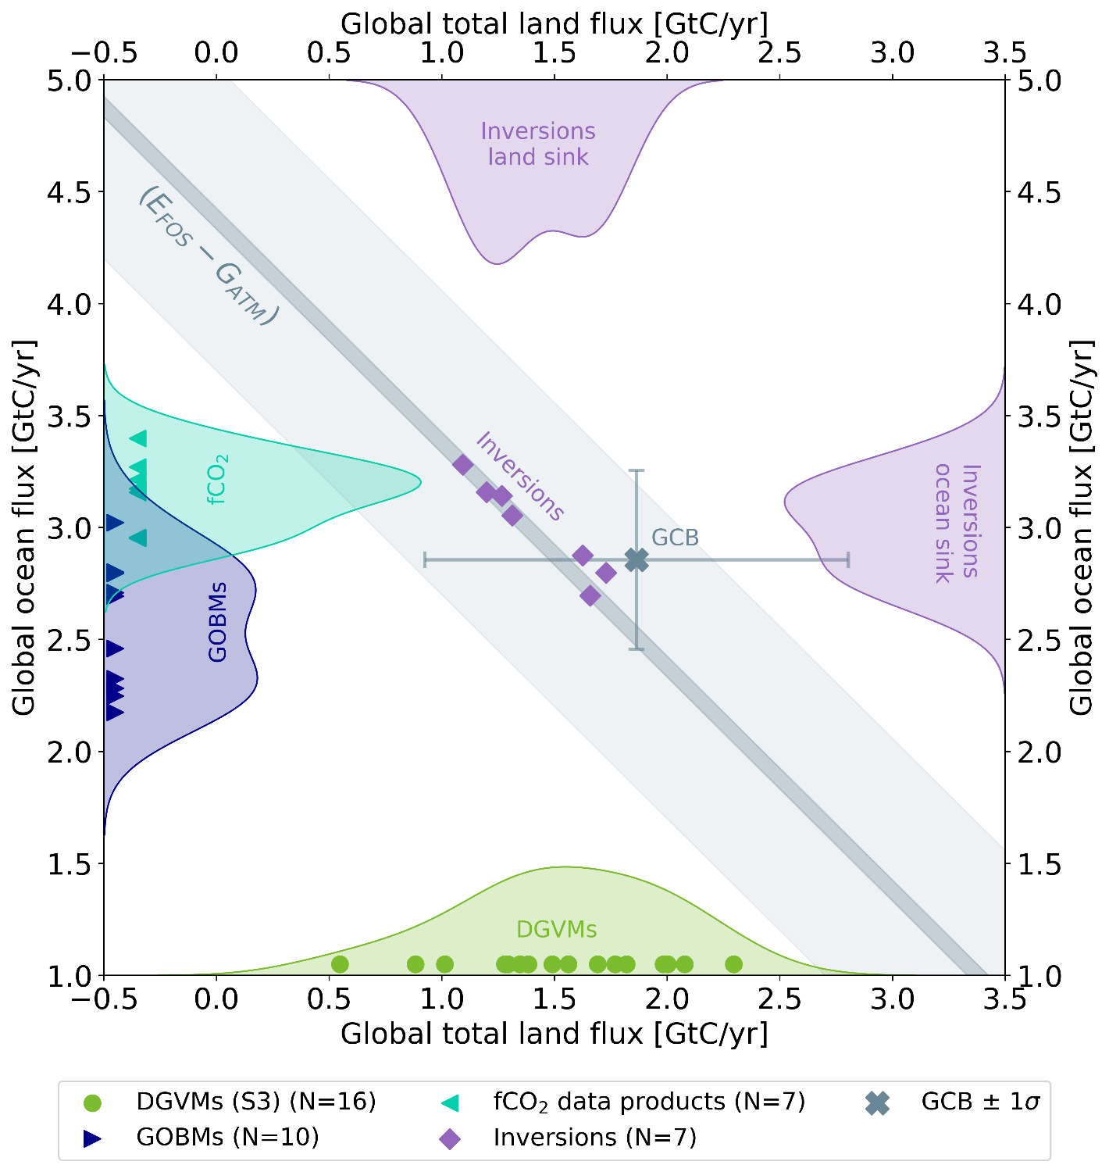
Land and ocean sinks — Estimates from atmospheric inversions
Atmospheric CO₂ inversions allow to estimate the land and ocean carbon fluxes, independently from the land and ocean process-based models estimates, confirming the global carbon budget estimates of the land and ocean partitioning of anthropogenic CO₂
CO₂ Sink
Note
Data are in GtC as in the ESSD publication.
Multiply by 3.664 to convert to GtCO₂
Source: Friedlingstein et al 2022; Global Carbon Budget 2022
CO₂ Source
CO₂ Sink

Slide 58
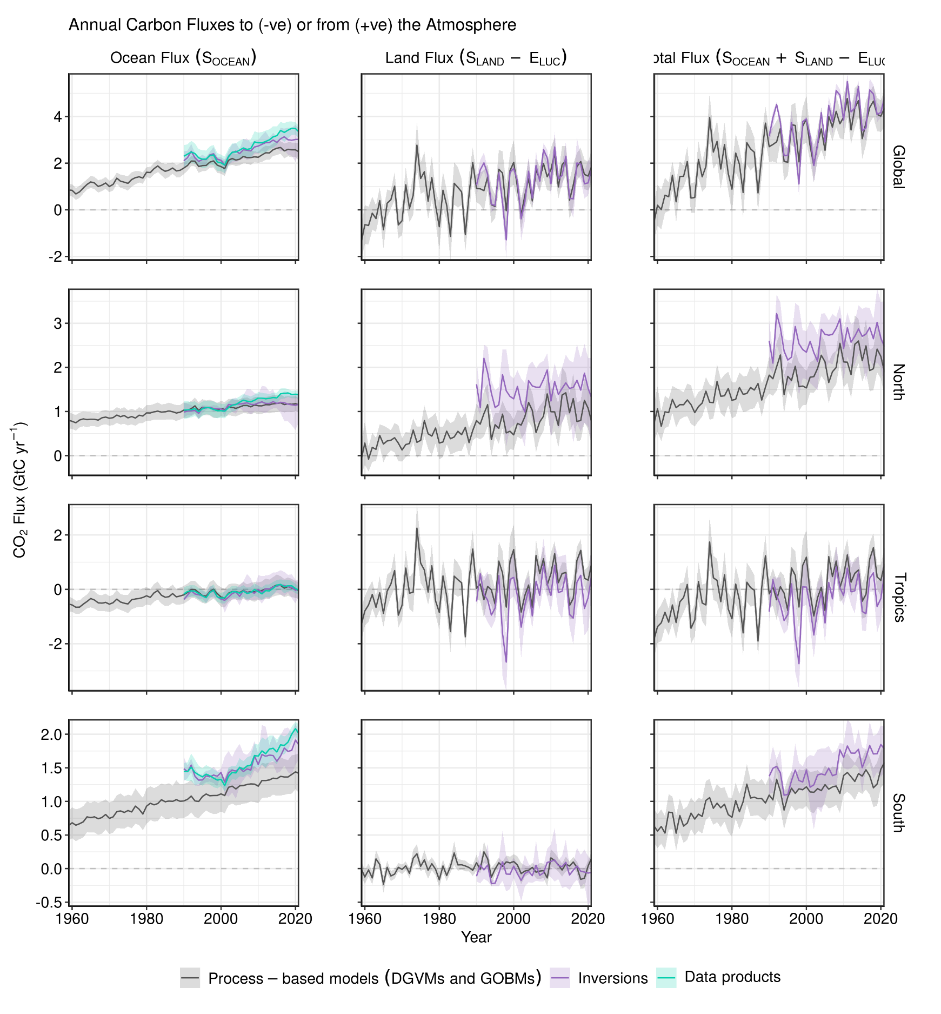
Total land and ocean fluxes
Total land and ocean fluxes show more interannual variability in the tropics
Note
Data are in GtC as in the ESSD publication.
Multiply by 3.664 to convert to GtCO₂
Source: Friedlingstein et al 2022; Global Carbon Project 2022

Slide 59

Remaining carbon budget imbalance
Large and unexplained variability in the global carbon balance caused by uncertainty
and understanding hinder independent verification of reported CO₂ emissions
positive values mean overestimated emissions and/or underestimated sinks
The budget imbalance is the carbon left after adding independent estimates for total emissions, minus the
atmospheric growth rate and estimates for the land and ocean carbon sinks using models constrained by observations
Source: Friedlingstein et al 2022; Global Carbon Project 2022

Slide 60

Global carbon budget
The cumulative contributions to the global carbon budget from 1850
The carbon imbalance represents the gap in our current understanding of sources & sinks
Source: Friedlingstein et al 2022; Global Carbon Project 2022

Slide 61

Remaining carbon budget
The remaining carbon budget to limit global warming to 1.5°C , 1.7°C and 2°C is
380 GtCO₂, 730 GtCO₂, and 1230 GtCO₂ respectively, equivalent to 9, 18 and 30 years from 2023.
2610 GtCO₂ have been emitted since 1750
The remaining carbon budgets are updated from IPCC AR6 WG1 Chapter 5 by removing additional historical emissions since 1 January 2020.
Quantities are subject to additional uncertainties e.g., future mitigation choices of non-CO₂ emissions
Source: IPCC AR6 WG1; Friedlingstein et al 2022; Global Carbon Budget 2022

Slide 62

Remaining carbon budget
Global CO₂ emissions must reach zero to limit global warming
Source: Friedlingstein et al 2022; Global Carbon Project 2022

Slide 63
Acknowledgements

Slide 64













Acknowledgements
The work presented in the Global Carbon Budget 2022 has been possible thanks to the contributions of hundreds of people involved in observational networks, modeling, and synthesis efforts.
We thank the institutions and agencies that provide support for individuals and funding that enable the collaborative effort of bringing all components together in the carbon budget effort.
We thank the sponsors of the GCP and GCP support and liaison offices.
We also want thank the EU/H2020 projects 4C (821003) and VERIFY (776810) that supported this coordinated effort as well as each of the many funding agencies that supported the individual components of this release. A full list in provided in Table A9 of Friedlingstein et al. 2022.
https://essd.copernicus.org/articles/14/4811/2022/
We also thanks the Fondation BNP Paribas for supporting the Global Carbon Atlas and the Integrated Carbon Observation System (ICOS) for hosting our data.
This presentation was created by Robbie Andrew and Pierre Friedlingstein with Pep Canadell, Glen Peters and Corinne Le Quéré in support of the international carbon research community.

Slide 65
Additional Figures

Slide 66
Additional Figures
Fossil CO₂

Slide 67

Top emitters: Fossil CO₂ Emissions
Emissions by country from 2000 to 2021, with the growth rates
indicated for the more recent period of 2016 to 2021
Source: Friedlingstein et al 2022; Global Carbon Project 2022

Slide 68

Per capita CO₂ emissions
Source: Friedlingstein et al 2022; Global Carbon Project 2022

Slide 69

Top emitters: Fossil CO₂ Emission Intensity
Emission intensity (emission per unit economic output) generally declines over time.
In many countries, these declines are insufficient to overcome economic growth.
GDP is measured in purchasing power parity (PPP) terms in 2010 US dollars.
Source: Friedlingstein et al 2022; Global Carbon Project 2022

Slide 70

Kaya decomposition
The Kaya decomposition illustrates that relative decoupling of economic growth from CO₂ emissions
is driven by improved energy intensity (Energy/GDP) &, recently, carbon intensity of energy (CO₂/Energy)
GDP: Gross Domestic Product (economic activity)
Source: Friedlingstein et al 2022; Global Carbon Project 2022

Slide 71

Fossil CO₂ emission intensity
The 10 largest economies have a wide range of emission intensity of economic activity
Emission intensity: Fossil CO₂ emissions divided by Gross Domestic Product (GDP)
Source: Friedlingstein et al 2022; Global Carbon Project 2022

Slide 72

Fossil CO₂ Emissions per capita
The 10 most populous countries span a wide range of development and emissions per capita
Emission per capita: Fossil CO₂ emissions divided by population
Source: Friedlingstein et al 2022; Global Carbon Project 2022

Slide 73

Alternative rankings of countries
The responsibility of individual countries depends on perspective.
Bars indicate fossil CO₂ emissions, population, and GDP.
GDP: Gross Domestic Product in Market Exchange Rates (MER) and Purchasing Power Parity (PPP)
Source: United Nations; Friedlingstein et al 2022; Global Carbon Project 2022

Slide 74

Breakdown of global fossil CO₂ emissions by country
Source: Friedlingstein et al 2022; Global Carbon Project 2022

Slide 75

Fossil CO₂ emissions by continent
Asia dominates global fossil CO₂ emissions, while emissions in North America
are of similar size to those in Europe, and the Middle East is growing rapidly.
Source: Friedlingstein et al 2022; Global Carbon Project 2022

Slide 76

Fossil CO₂ emissions by continent: per capita
Oceania and North America have the highest per capita emissions, while the Middle East has recently overtaken Europe.
Africa has by far the lowest emissions per capita.
Source: Friedlingstein et al 2022; Global Carbon Project 2022

Slide 77
Additional Figures
Consumption-based Emissions
Consumption–based emissions allocate emissions to the location that goods and services are consumed
Consumption-based emissions = Production/Territorial-based emissions minus emissions embodied in exports plus the emissions embodied in imports

Slide 78

Consumption-based emissions (carbon footprint)
Allocating fossil CO₂ emissions to consumption provides an alternative perspective.
USA and EU28 are net importers of embodied emissions, China and India are net exporters.
Consumption-based emissions are calculated by adjusting the
standard production-based emissions to account for international trade
Source: Peters et al 2011; Friedlingstein et al 2022; Global Carbon Project 2019

Slide 79

Consumption-based emissions per person
The differences between fossil CO₂ emissions per capita is larger than the
differences between consumption and territorial emissions.
Consumption-based emissions are calculated by adjusting the
standard production-based emissions to account for international trade
Source: Peters et al 2011; Friedlingstein et al 2022; Global Carbon Project 2022

Slide 80

Consumption-based emissions (carbon footprint)
Transfers of emissions embodied in trade between OECD and non-OECD countries grew
slowly during the 2000’s, but has since slowly declined.
Source: Peters et al 2011; Friedlingstein et al 2022; Global Carbon Project 2022

Slide 81

Major flows from production to consumption (2011) – Fossil CO₂
Flows from location of generation of emissions to location of
consumption of goods and services
Values for 2011. EU is treated as one region. Units: MtCO₂
Source: Peters et al 2012

Slide 82

Major flows from extraction to consumption (2011) – Fossil CO₂
Flows from location of fossil fuel extraction to location of
consumption of goods and services
Values for 2011. EU is treated as one region. Units: MtCO₂
Source: Andrew et al 2013

Slide 83


Major flows from production to consumption (2017) — Land Use Change CO₂
Global distribution of land-use change emissions embodied in trade: Arrows show largest flows from location of generation of emissions to location of consumption of agricultural and forestry goods.
MtCO₂ yr⁻¹
Values for 2017. EU27 is treated as one region. Units: MtCO₂
Source: Hong et al 2022

Slide 84
Additional Figures
Historical Emissions

Slide 85

Total global emissions by source
Land-use change was the dominant source of annual CO₂ emissions until around 1950.
Fossil CO₂ emissions now dominate global changes.
Others: Emissions from cement production, gas flaring and carbonate decomposition
Source: Friedlingstein et al 2022; Global Carbon Project 2022

Slide 86

Historical cumulative emissions by source
Others: Emissions from cement production, gas flaring and carbonate decomposition
Source: Friedlingstein et al 2022; Global Carbon Project 2022

Slide 87

Historical cumulative fossil CO₂ emissions by country
‘All others’ includes all other countries along with emissions from international aviation and maritime shipping
Source: Friedlingstein et al 2022; Global Carbon Project 2022

Slide 88

Historical cumulative emissions by continent
Cumulative fossil CO₂ emissions (1850–2021). North America and Europe have
contributed the most cumulative emissions, but Asia is growing fast
The figure excludes emissions from international aviation and maritime shipping
Source: Friedlingstein et al 2022; Global Carbon Project 2022

Slide 89
Additional Figures
Energy Use

Slide 90

Energy use by source
Energy consumption by fuel source from 2000 to 2021, with growth rates
indicated for the more recent period of 2016 to 2021
This figure shows “primary energy” using the BP substitution method
(non-fossil sources are scaled up by an assumed fossil efficiency of approximately 0.38)
Source: BP 2022; Global Carbon Project 2022

Slide 91

Energy use in China
Coal consumption in energy units has returned to peak levels,
while consumption of all other energy sources is growing strongly
Source: BP 2022; Global Carbon Project 2022

Slide 92

Energy use in USA
Coal consumption has declined sharply in recent years with the shale gas boom
and strong renewables growth. Output from nuclear power is slowly declining as stations are retired.
Source: BP 2022; Global Carbon Project 2022

Slide 93

Energy use in the European Union
Consumption of both oil and gas has rebounded in recent years, while coal continues to decline.
Renewables are growing strongly, now providing more energy than nuclear power.
Source: BP 2022; Global Carbon Project 2022

Slide 94

Energy use in India
Pandemic year 2020 temporarily interrupted India’s strong growth in energy consumption.
Consumption of coal and oil dominate.
Source: BP 2022; Global Carbon Project 2022

